Slide 1
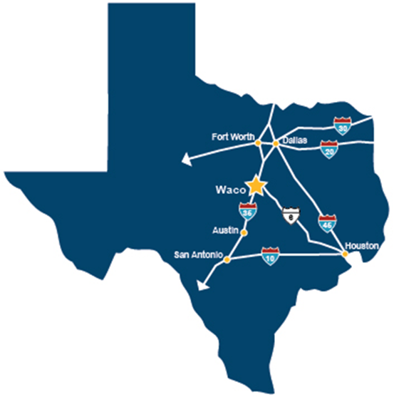
Urbanization
Texas Urban Triangle Regional Center
Urban Centers of the World
Unit 3 Lesson 8

Slide 2
Essential ?
What are the similarities and differences of the most significant cities in each of the cultural regions of the world?

Slide 3
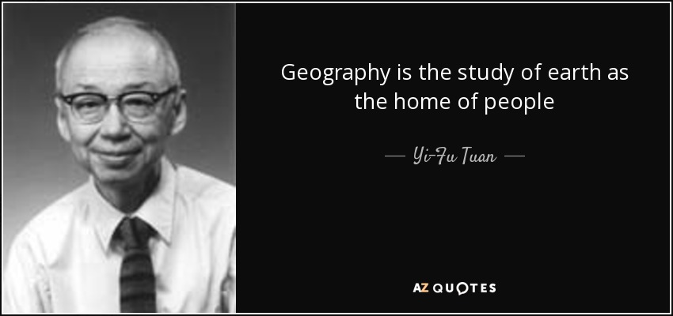
Map Items on SIM
Caracas, Venezuela
Bogota, Colombia
Sao Paulo, Brazil
Rio De Janeiro, Brazil
Buenos Aires, Argentina
Mexico City, Mexico
Gulf of Mexico
Yucatan Peninsula
Caribbean Sea
Athens, Greece
Rome, Italy
Moscow, Russia
Berlin, Germany
Paris, France
London, United Kingdom
Tokyo, Japan
New York City, United States
Los Angeles, United States
Damascus, Syria
Tehran, Iran
Baghdad, Iraq
Arabian Peninsula
Abu Dubai, United Arab Emirates
Kuwait City, Kuwait
Umm Qasr, Iraq
Mumbai, India
New Delhi, India
Karachi, Pakistan
Jerusalem, Israel
Islamabad, Pakistan
Shanghai, China
Beijing, China
Washington, DC.
Singapore

Slide 4
No Vocab ☺

Slide 5
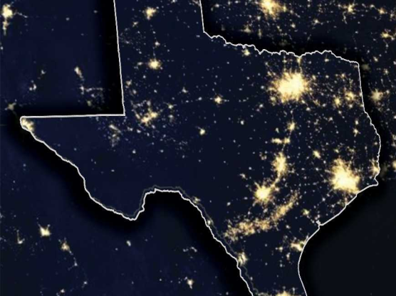
Earth @ Night Discussion
Where are the majority of the lights clustered?
What can you interpret about the areas around where the lights are clustered?
What would you tell someone who was not looking at this picture what Earth @ night looked like?
4) How would you compare the Texas @ Night picture from the Earth @ Night picture?

Slide 6
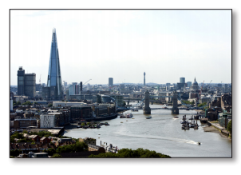
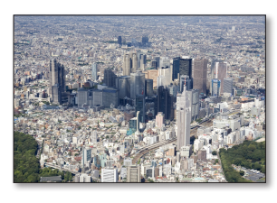
Group Brainstorm & Think, Pair, Share
Complete in your Geography Journal
At your group, Identify the following influences for these significant cities:
Population
Economic
Social
Political
New York City
London
Tokyo

Slide 7
Work Time ☺
Complete IR-33
Using Reading from IR-34

