Slide 1
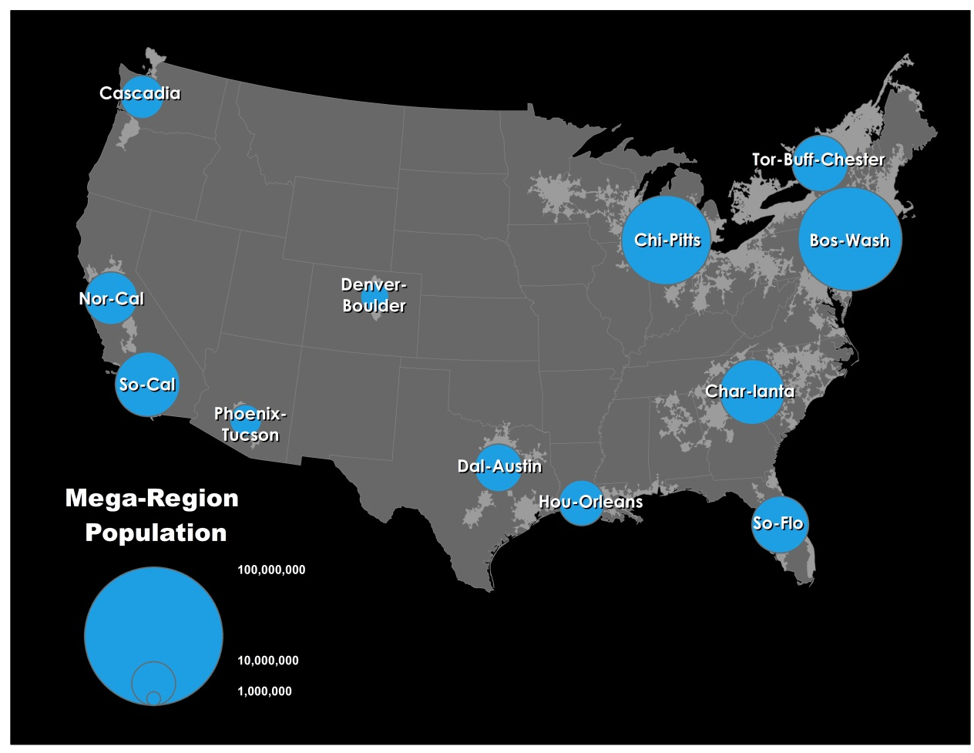
Urbanization
Unit 3 Lesson 6: Megalopolis

Slide 2
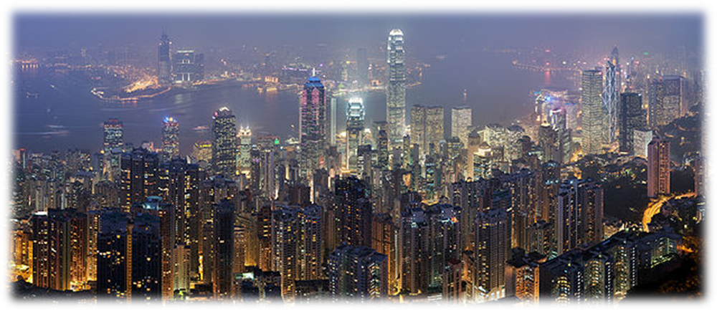
Essential ?’s
How do the physical features that characterize the boundaries of a megalopolis help to create a uniqueness to this region?
What are the unique physical & human characteristics that allow New York City to be the most dominant city in the United States?

Slide 3
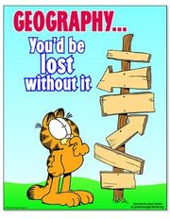
Map Items on SIM
Boston
Washington, DC.
Philadelphia
New York City
Merrimack River
Delaware River
Potomac River
Hudson River
East River
Atlantic Ocean
White Mountains
Green Mountains
Pocono Mountains
Maryland
Virginia

Slide 4
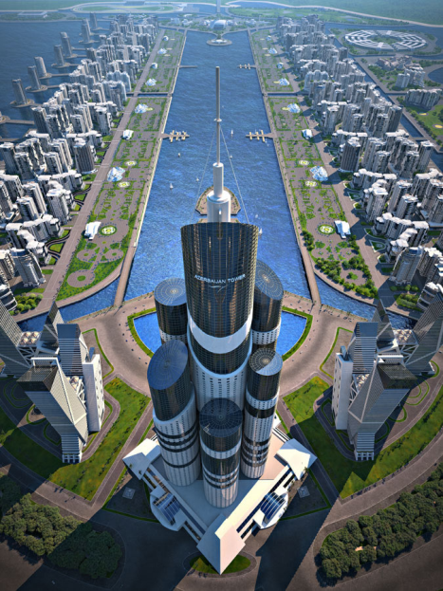
Vocabulary
Megalopolis - a chain of roughly adjacent metropolitan areas.
Artificial City – not created for trade or connection with other people. Has a specific political purpose. Ex…Washington, D.C.
Break-of-Bulk – point exists where cargo is transferred from 1 mode of transportation to another.

Slide 5
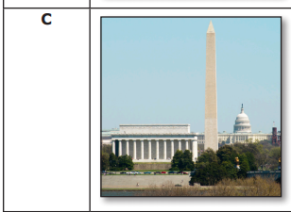
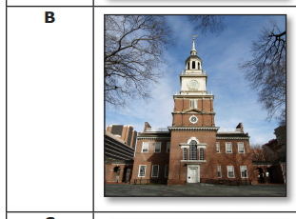
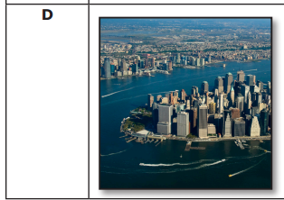
Class Discussion
Boston
Harbor
What are your observations?
What does the photo tell you about the city?
What is not included in the photo that would help you better understand the city?
Washington
D.C.
Boston
Mass.
New York City

Slide 6
Group Activity
Group Card Sorting
Match contents of bag into correct groups
1st group with All Correct gets some candy! ☺

Slide 7
Time to Work ☺
Complete IR-25
Using Reading from IR-26

