Slide 1
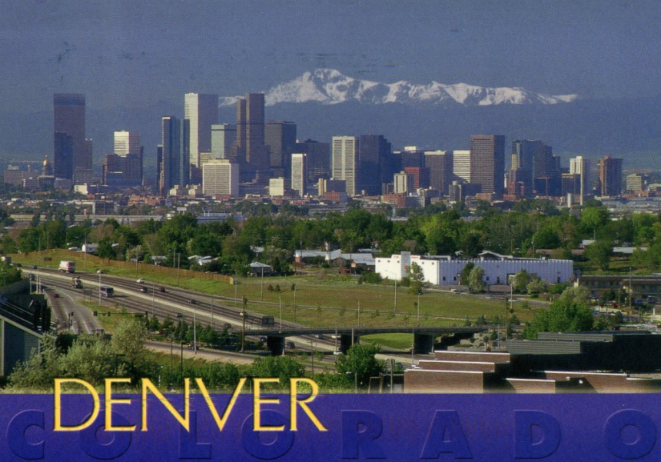
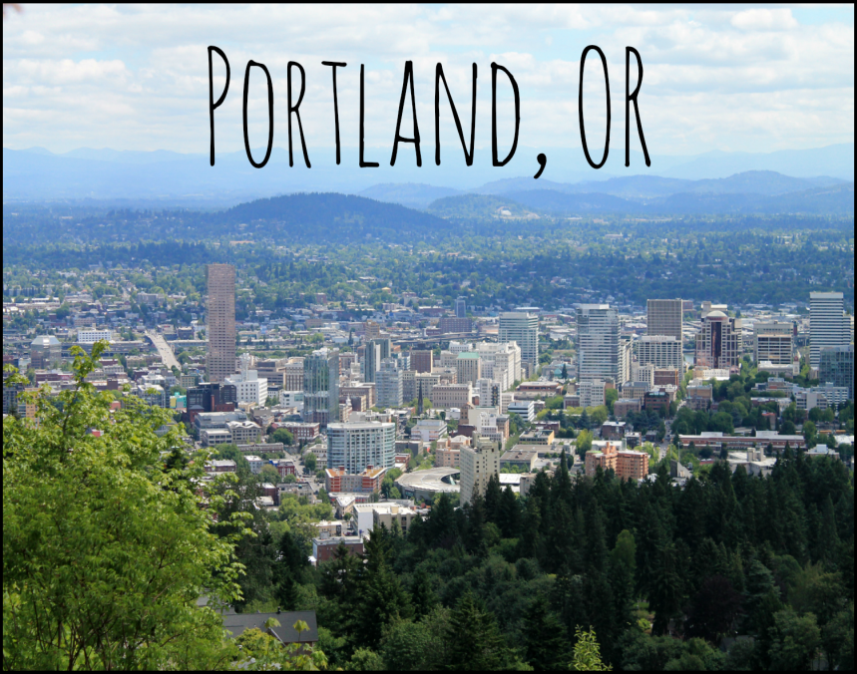
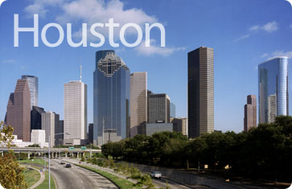
Urbanization
Unit 3 Lesson 5: Regional Cities

Slide 2
Essential ?’s
What is the importance on a regional scale of cities such as Denver, Colorado & Portland, Oregon?
What is the regional importance of the largest major city closest to where you live?

Slide 3
Map Items on SIM
Denver
Portland, Oregon
Seattle
Los Angeles
San Diego
Boston
Atlanta
Dallas
Chicago
San Francisco
New York City
Philadelphia
Cleveland, Ohio
Richmond, Virginia
St. Louis
Minneapolis
Kansas City, Missouri
Miami
New Orleans
Houston
Detroit
Washington, DC.
Cincinnati

Slide 4
No Vocab. ☺

Slide 5
Map Discussion
How does this map verify the Central Place Theory? In regards too Denver, Colorado & Portland, Oregon
What human & physical features could influence the cities of Denver, Colorado & Portland, Oregon?

Slide 6
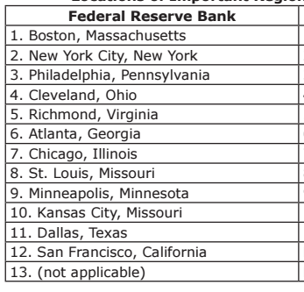
Map on IR-19

Slide 7
Work Time ☺
Complete IR-21
Using Reading from IR-20

