Slide 1
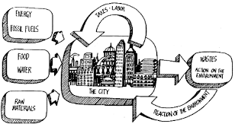
URBANIZATION
UNIT 3 LESSON 4: CENTRAL PLACE THEORY

Slide 2
ESSENTIAL ?
In your community, what cities fit the hierarchy of cities (small-medium-large) as outlined in the central place theory.

Slide 3
NO MAP ITEMS IN THIS LESSON ☺

Slide 4
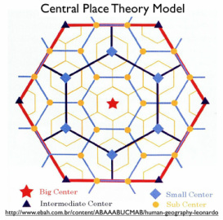
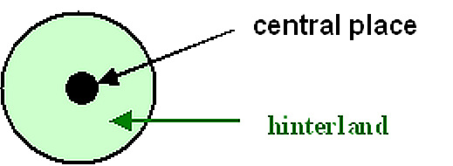
VOCABULARY
Central Place Theory - (CPT) is an attempt to explain the spatial arrangement, size, and number of settlements. The theory was originally published in 1933 by a German geographer Walter Christaller who studied the settlement patterns in southern Germany.
Hinterland – surrounding land.

Slide 5
VISUALIZE/CLASS DISCUSSION
What pictures did you see in your mind as you listened to the reading?
What experiences have you had that are similar to the description?

Slide 6
MAP FOR EXTRA CREDIT!! ☺

Slide 7
WORK TIME ☺
Complete IR-16
Using Reading from IR-17

Slide 8
IR-16 Notes
Creator: Walter Christaller
Purpose: each central place, or city, exists to serve a specific function or purpose
Theory: a way to look at spatial organization of places
Hinterland: surrounding area
Holes: don’t exist between cities/places
Overlap: places overlap in their purposes
Hexagons: the shape used to map cities and their functional radius

