Slide 1
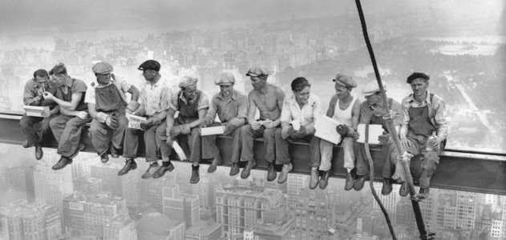
Urbanization
Unit 3 Lesson 3
Functions of Cities

Slide 2
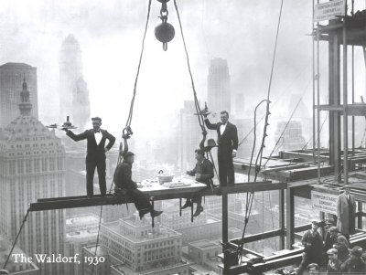
Essential ?’s
What are the differences between cottage and commercial industries?
What are the different functions of cities?

Slide 3
Map Items on SIM
Durban, South Africa
Hong Kong, China
Houston, United States
Mumbai, India
Ney York City, United States
Shanghai, China
Singapore
Bangkok, Thailand
Detroit, United States
Liverpool, England
Monterrey, Mexico
Port Elizabeth, South Africa
Sao Paulo, Brazil
Yokohama, Japan
Abuja, Nigeria
Ankara, Turkey
Brasilia, Brazil
Islamabad, Pakistan
Naypyidaw, Myanmar
Ottawa, Canada
Washington, DC., United States
Dubai, United Arab, Emirates
Hollywood, United States
Milan, Italy
Las Vega, United States
Jerusalem, Israel
Monaco
Varanasi, India

Slide 4
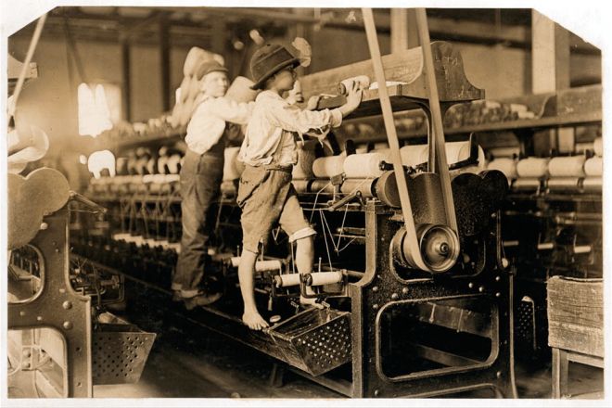
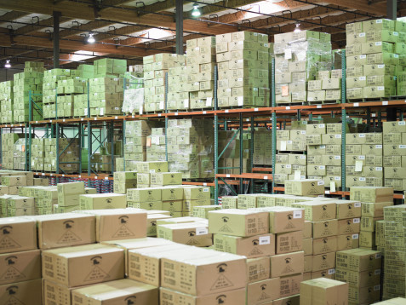
Vocabulary
Cottage Industry – People work out of their homes to create homemade, small-scale goods
Industrialization – Caused economies to change from a cottage industry to a commercial industry
Commercial Industry – Efficient & systematic approach to mass-produce goods and services, including the use of machinery.

Slide 5
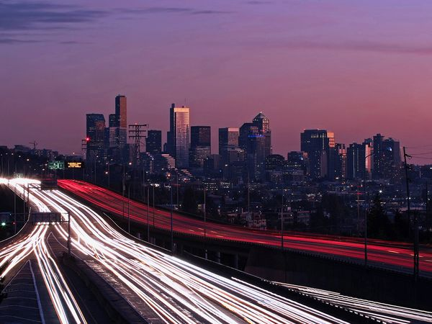
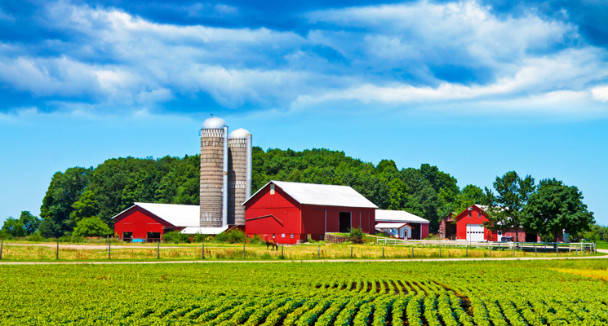
Class Discussion
https://www.youtube.com/watch?v=umS3XM3xAPk
Why do people move to cities?
What services/activities may be available in a large city that are not available in a smaller town or rural area?

Slide 6
Time to Work! ☺
Use Reading from IR-13 to Complete IR-12
Brain Storm
Use your own ideas to complete IR-11
Your opinion is not wrong
Only if it is blank or answered with IDK, is it wrong!!!

Slide 7
Reflection in Geographer Journal
Choose your prompt and write 5-8 sentences:
Pretend you are a worker who has moved from a rural location to a city in order to work in a factory. Write a diary response (1st person) about your experiences in your new job and location.
Description of what you do in the factory. (Machines & Mass production)
Supplementary businesses you use that were not present in your former rural location. (Tutti Frutti, Neman Marcus, Starbucks)
A service you access in the city that was not available in your former rural location. (Dog Park, Bike-to-Work)
Do on Separate piece of paper & turn in. Mandatory assignment will replace your lowest grade. ☺ Still must do!!! ☺

