Slide 1
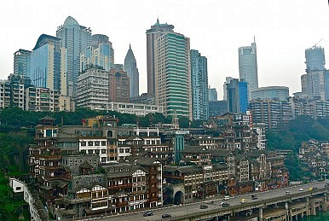
Urbanization
Unit 3 Lesson 2
Location & Interaction

Slide 2
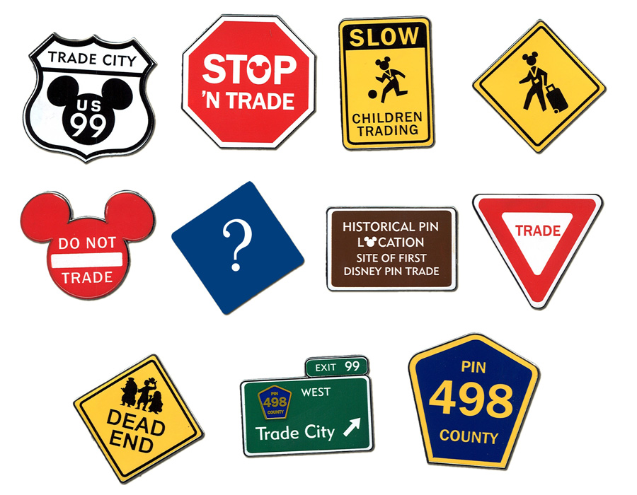
Lesson 2: Cities - Location and Interaction
Essential ?
What is the connection between international trade and the location of significant cities?

Slide 3
Map Items on SIM
Sierra Madre Occidentals
Sierra Madre Orientals
Nile River
Indus River
Huang He River
Atlantic Ocean
Casablanca, Morocco
Cape Town, South Africa
Durban, South Africa
Mogadishu, Somalia
Mombasa, Kenya
Alexandria, Egypt
Istanbul, Turkey
Jeddah, Saudi Arabia
Mumbai, India
Kozhikode, India
Kolkata, India
Hong Kong, China
Singapore
New York City, United States
Santo Domingo, Dominican Republic
Charleston, United States
Vancouver, Canada
Athens, Greece
St. Petersburg, Russia
Paris, France
Rome, Italy
Isfahan, Iran
Dunhuang, China
Beijing, China
Lhasa, Tibet
Mongolia
London, England
Tokyo, Japan
Chicago, United States
Milan, Italy
Sao Paulo, Brazil
Amsterdam, Netherlands
Bangkok, Thailand
Los Angeles, United States
Seoul, South Korea
Moscow, Russia
Brussels, Belgium
Jakarta, Indonesia
Washington, DC., United States
New Delhi, India

Slide 4
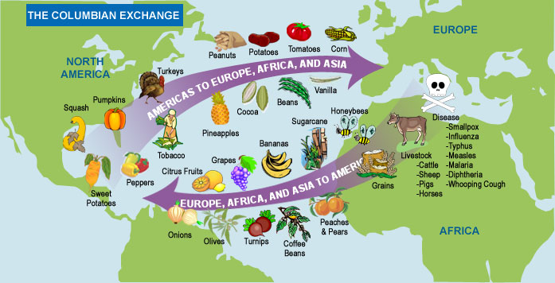
Vocabulary
Columbian Exchange - refers to a period of cultural and biological exchanges between the New and Old Worlds. Exchanges of plants, animals, diseases and technology transformed European and Native American ways of life.

Slide 5
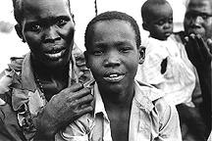
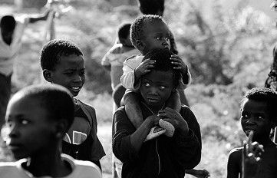
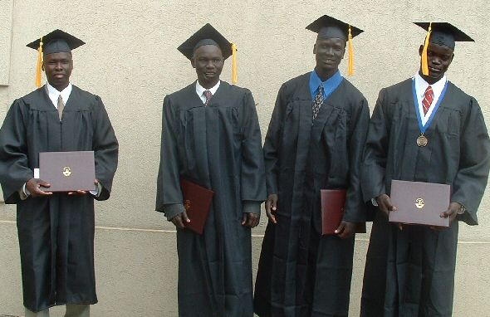
Class Discussion
https://www.youtube.com/watch?v=253XGgQeweI
Identify the characteristics from the video:
Political
Economic
Social
Cultural

Slide 6
Work Time ☺
Complete Chart from IR-8 using the Reading IR-7

