Slide 1
Unit 2 Review

Slide 2
Define Economy
Deals with the production, consumption, and transfer of money

Slide 3
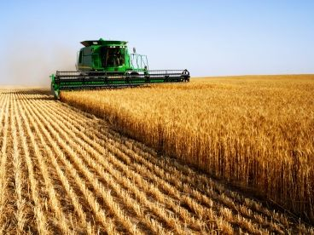
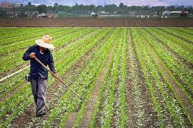
Order these three terms in the correct order:
Commercial Revolution
Neolithic Revolution
Green Revolution
How do modern technologies help farmers?

Slide 4
Where did the Industrial Revolution begin? How?
Video link

Slide 5
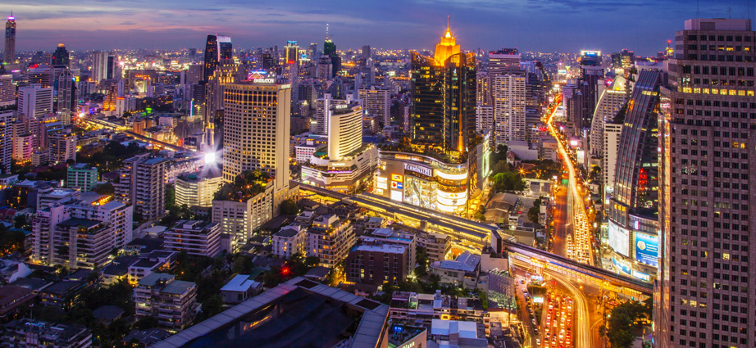
Create an annotated timeline of development using these terms:
De-Industrialized
Industrialized
Newly Industrialized
Undeveloped

Slide 6
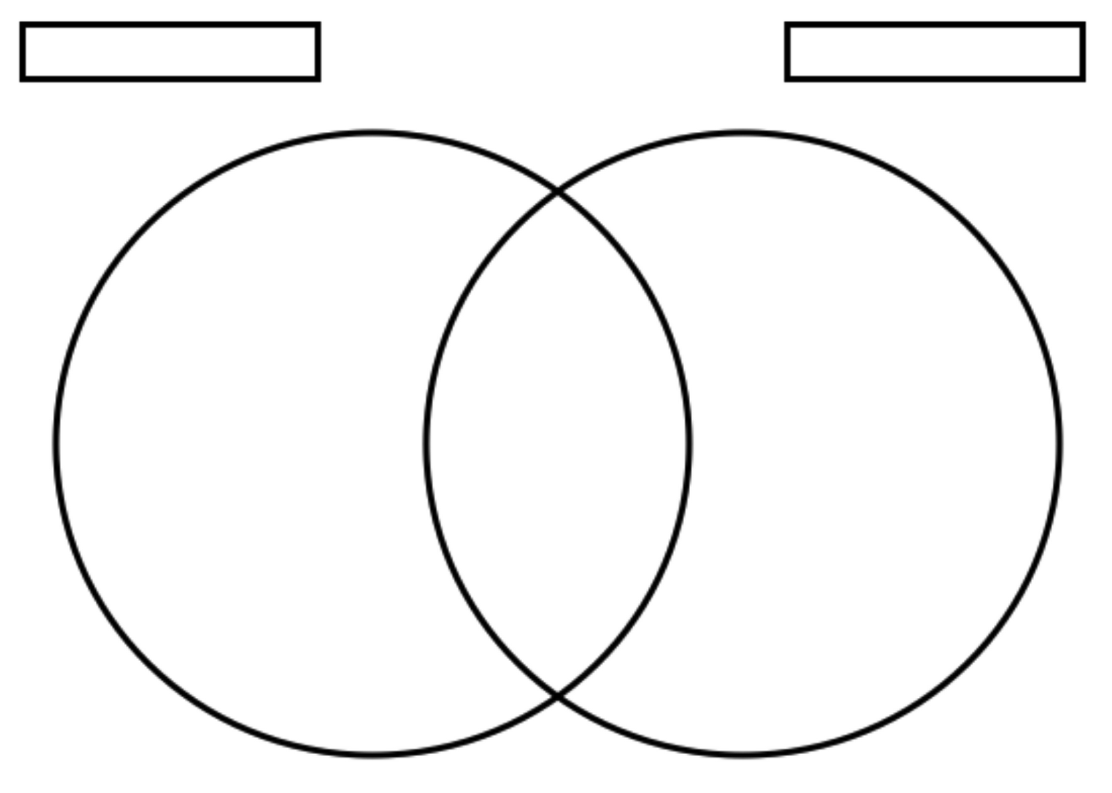
Compare and Contrast
Economic Sectors
Economic Systems

Slide 7
What is the purpose of supranational organizations?
Discuss, then take notes.

Slide 8
What is OPEC?
Video Link

