Slide 1
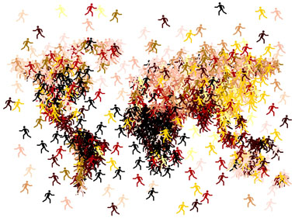
The Human Mosaic
Unit 4 Lesson 6
Religious Conflicts

Slide 2
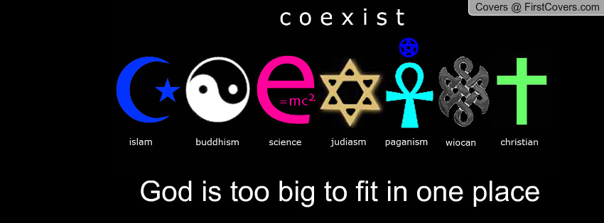
Essential ?’s
In what ways are the conflicts in Southwest Asia and Kashmir similar?
How is the conflict in Tibet different from those in other countries?

Slide 3
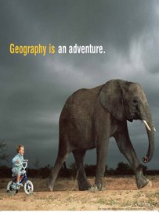
Map Items on SIM
Israel
Palestine
Jerusalem
Egypt
Jordan
Iraq
Syria
Lebanon
Golan Heights
Gaza Strip
India
Kashmir
Sri Lanka
Tibet
China
Lhasa
Beijing
Northern Ireland
Republic of Ireland
United Kingdom

Slide 4
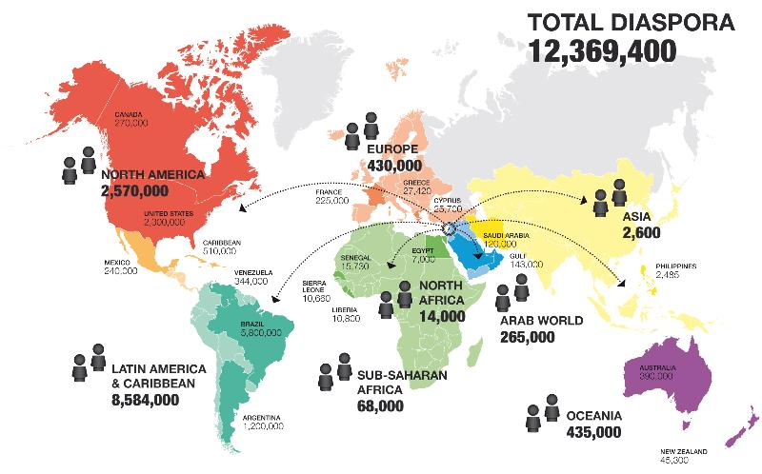
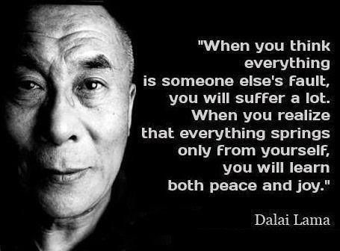
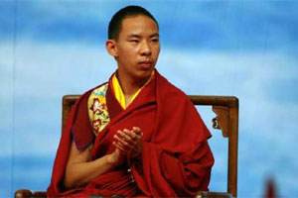
Vocabulary
Diaspora – around 70 AD, time religious conflict goes back to, Romans demolished Jerusalem and expelled Jews from the region.
Autonomous – independent or self-governing
Dalai Lama – political and spiritual leader of Tibetan Buddhists.
Panchen Lama – the 2nd highest ranking political and spiritual leader of Tibetan Buddhists

Slide 5
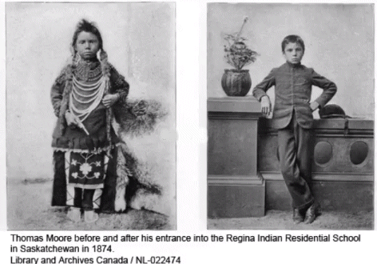
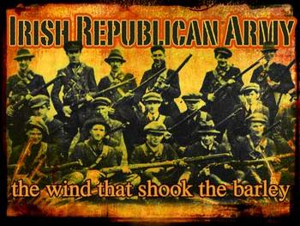
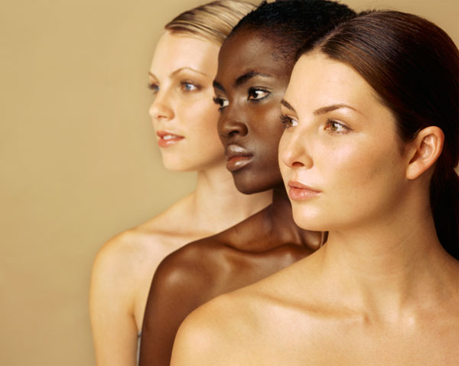
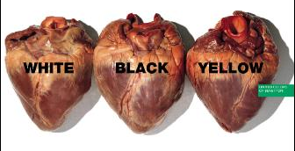
Vocab. Continued
Cultural Genocide - is the systematic destruction of traditions, values, language, and other elements which make a one group of people distinct from other groups.
Irish Republican Army – a paramilitary group, organized to force the end of British occupation of Northern Ireland and encourage politically unified Ireland.
Ethnicity – the common ancestral or cultural characteristics within a group of people.

Slide 6
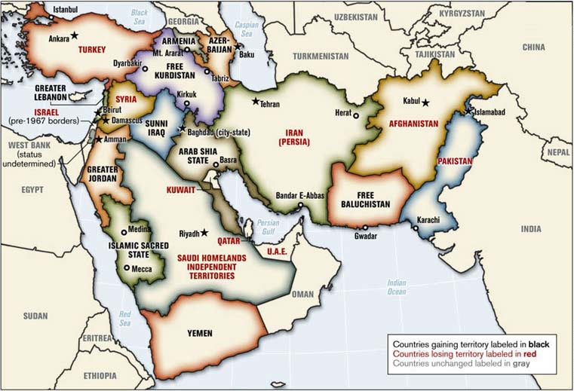
Class Discussion
What is the 1st thing that comes to your mind when you hear the phrase “the Middle East”
Where do you think the Middle East is located?
What countries are included in the Middle East?
What are the characteristics of the Middle East?
http://www.wsj.com/video/saudi-arabia-vs-iran-the-sunni-shiite-proxy-wars/A7B70696-9A6D-4B26-88EC-BBFDD44AE112.html
What aspects of religious conflict do you see in the video?
What questions do you still have about this conflict?

Slide 7
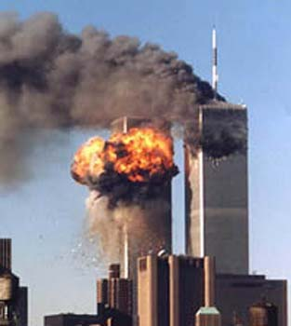
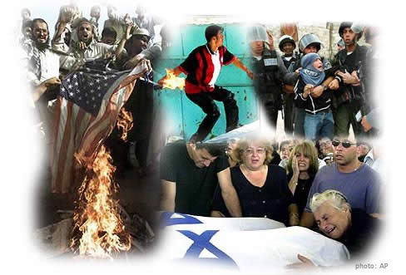
Group Work
In Groups complete IR-28 using Religious Conflict articles.

Slide 8
Video Analysis
https://www.youtube.com/watch?v=FbWmBUONtFY
What would you do?
How can you be more accepting and prevent prejudice?

Slide 9
Time for Work ☺
Read IR-29 and complete IR-30

