Slide 1
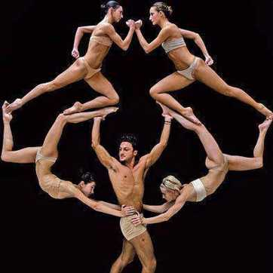
THE HUMAN MOSAIC
Unit 4 Lesson 3
Cultural Diffusion

Slide 2
ESSENTIAL ?’S
What are examples of American culture that have diffused to other parts of the world?
What are examples of culture that have diffused to the United States?

Slide 3
MAP ITEMS ON SIM
North America
South America
Asia
Africa
United States
Canada
India
Nigeria
Barbados
Hong Kong
Singapore
Australia
Athens, Greece
Rome, Italy
United Kingdom
Dominican Republic
Puerto Rico
Japan

Slide 4
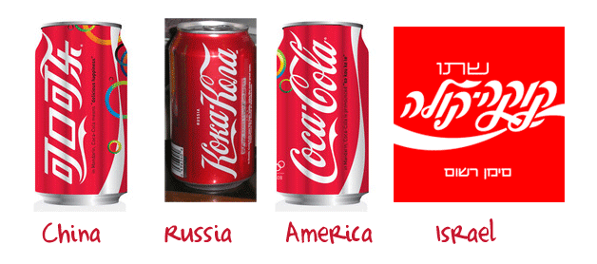
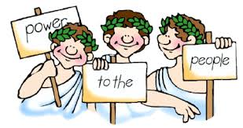
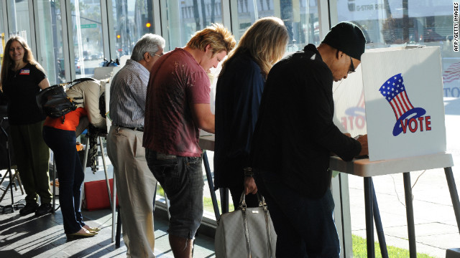
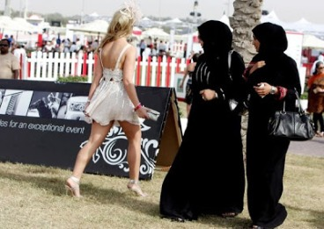
VOCABULARY
Diffusion – concept of culture and ideas moving
Cultural Diffusion – movement of cultural traits and ideas from one place to another.
Direct Democracy – required all citizens to participate directly in government.
Each citizen votes on issues & serves on juries.
Representative Democracy – election of representatives to make decisions for the masses.
Acculturation – process by which cultural characteristics of one group of people become the normal exception in another region.

Slide 5
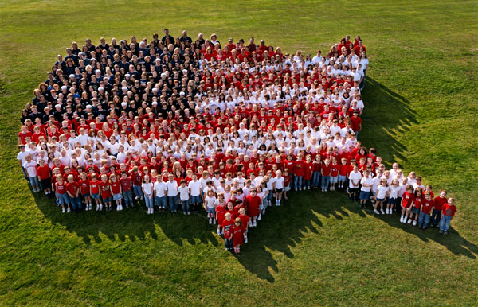
VIDEO ANALYSIS
Identify as many cultural aspects from the video as you can
https://www.youtube.com/watch?v=xM50XlTTWhM
How did this make you reflect on your own culture and patriotism?
What makes you proud of the country you come from?

Slide 6
AS A CLASS
Discuss and Complete Chart from IR-10

Slide 7
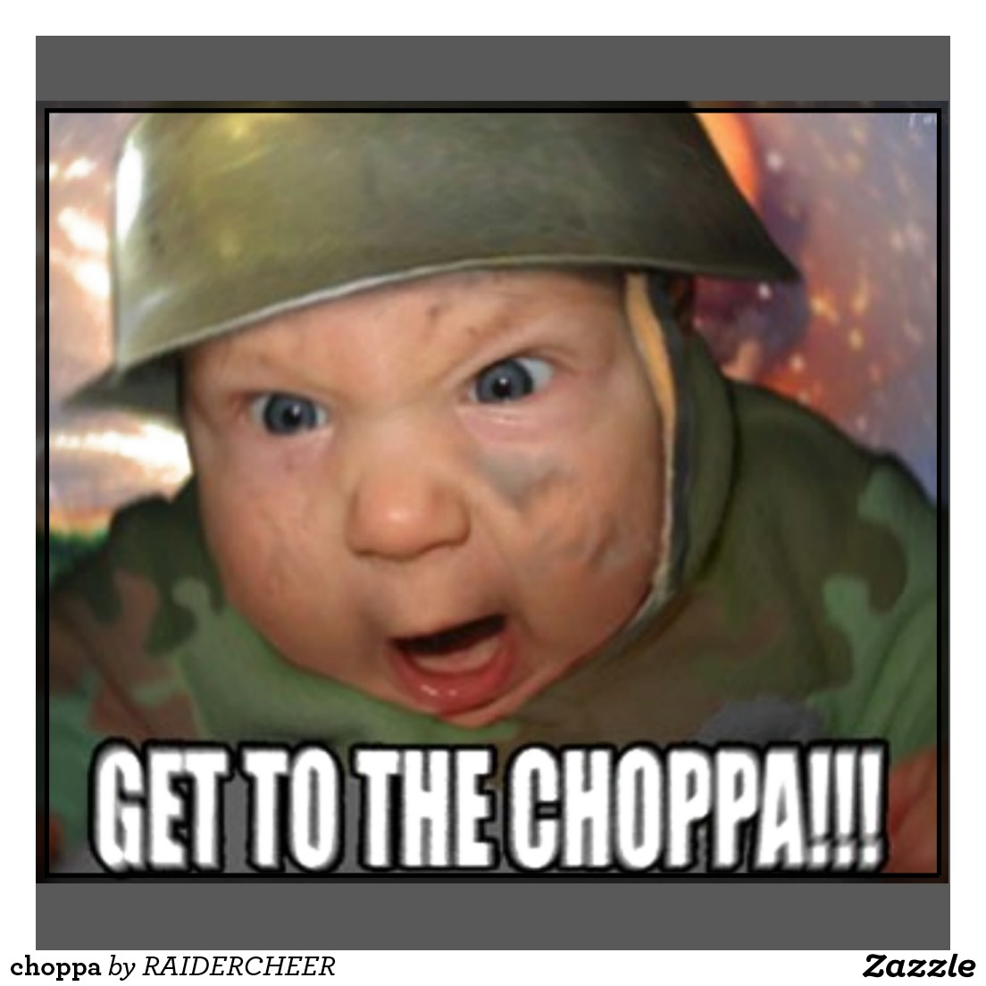
ON YOUR OWN
Read IR-11 and Complete IR-12 & IR-13

