Slide 1
Population and Migration
Unit 5 Lesson 1
Introduction to Demography

Slide 2
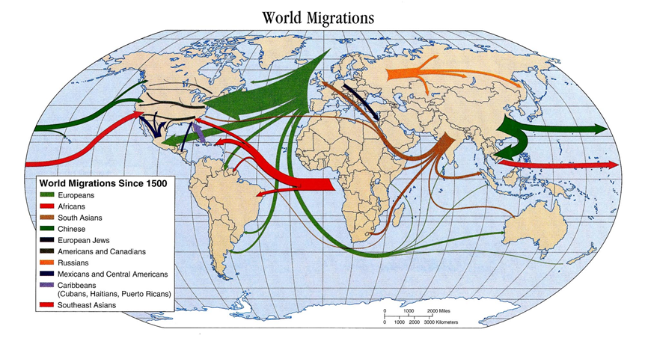
Essential ?’s
What topics are identified as a part of demography, or the study of human geography?
How is the study of demographics a good predictor of standard of living?

Slide 3
Map Items on SIM
Zimbabwe
Libya
Costa Rica
Haiti
United States
Italy
Russia
Israel
Yemen
Maldives
Afghanistan
Singapore
Cambodia
Japan
North Korea

Slide 4
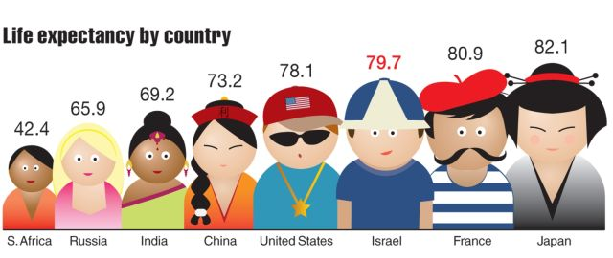
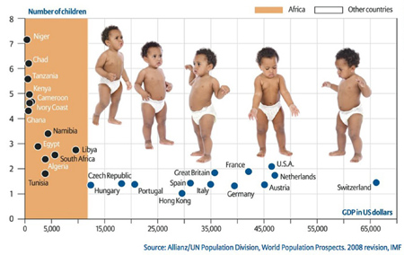
Vocabulary
Demography – the study of statistics such as births, deaths, income, or the incidence of disease, which illustrate the changing structure of human populations.
Life Expectancy – the # of years people are expected to live.
Fertility Rate – the average # of children born to a woman during her lifetime.

Slide 5
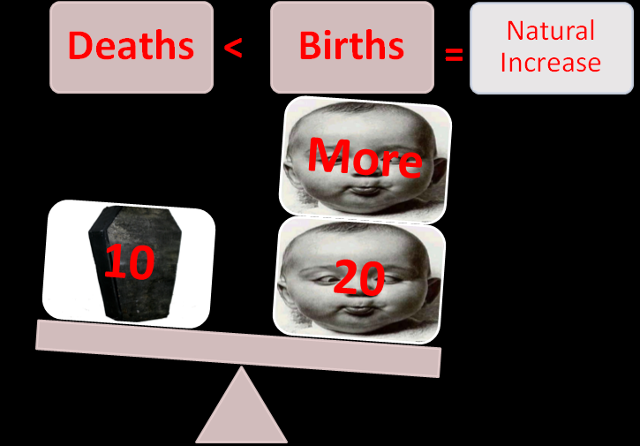
Vocab. Continued
Literacy Rate – the % of people who can read & write their language.
Rate of Natural Increase – growth rate.
J-curve – concept that helps us understand the growth of global population over time.

Slide 6
Population Geography
In groups – Imagine the 10 objects in the bag represent the entire population of the world.
Estimate the % of male & female
Children vs adults
Population living on each continent
Literate vs illiterate
Starving, undernourished, overweight, & extreme wealthy
How do your estimates compare to the chart on IR-1 inside the bag?
Were your answers close to the chart and what surprised you?
https://www.youtube.com/watch?v=i4639vev1Rw

Slide 7
Demographic Data Discussion
Discussion ?’s:
Which area of the world has the lowest life expectancy?
What conclusions might you draw about an area of the world based on its fertility rate?
What countries have the highest literacy rates among Men? Women?
What do you think these three factors – life expectancy, fertility rate, and literacy rate – mean in terms of standard of living?

Slide 8
Work Time ☺
Using the reading from IR-4
Complete the KIM Chart on IR-3

Slide 9
Journal Time – Turn Writing into Basket
Explain how the study of demographic information can be used to make economic, social, and political decisions.
Include specific examples and use the terminology you learned from the lesson. ( Go back into the reading)

