Slide 1
Political Geography & Globalization
UNIT 6 LESSON 8
CULTURAL GLOBALIZATION

Slide 2
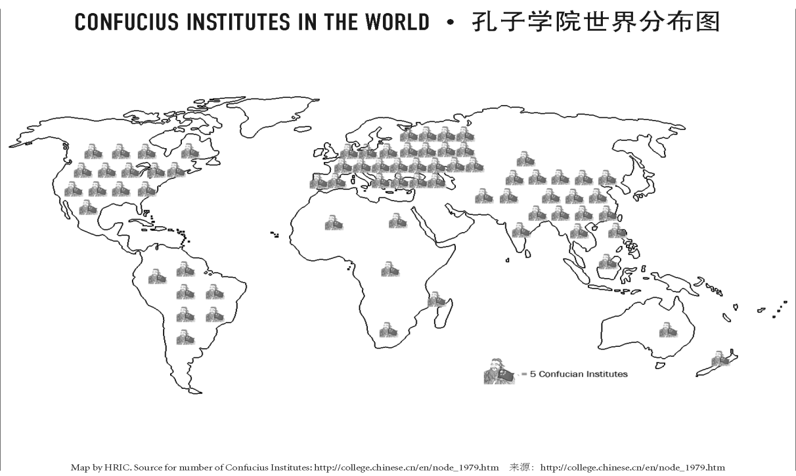
Essential ?’s
How do Confucius Institutes diffuse Chinese culture?
Which language is spoken throughout the world by more people, either as a 1st or 2nd language?

Slide 3
Map Items on SIM
China
United States
Russia
Korea
England
France
Thailand
Iran
Pakistan
Indonesia
Athens
Rome
South Africa
Bosnia
Ukraine
Kyrgyzstan

Slide 4
NO VOCABULARY!!!

Slide 5
Class Discussion Before & After Audio Clip
What is the best way to learn a new language?
What challenges do people face when moving to a place where their native language is not spoken?
http://www.audio-lingua.eu/?lang=en
Teachers select which ever language you want.
What did you feel like when you first heard the audio?
How would you feel if this entire class were conducted in a language you didn’t know but were going to be tested over?

Slide 6
Work Time ☺
Complete IR/37,39,40
Using Reading from IR-38

