Slide 1
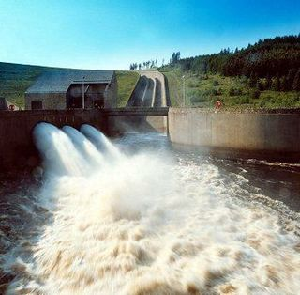
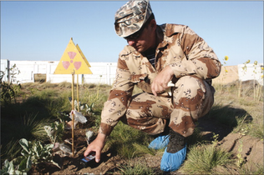
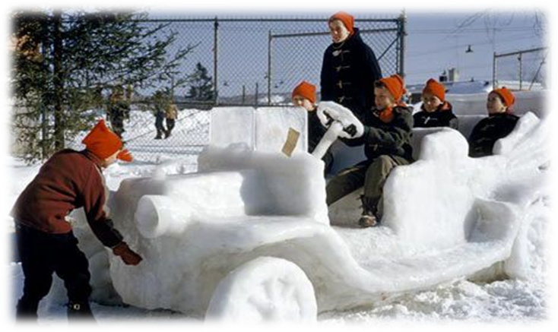
ECONOMIC GEOGRAPHY & DEVELOPMENT
Unit 2 Lesson 8
Human-Environment Interaction

Slide 2
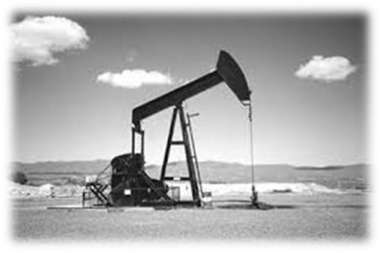
Essential ?’s
What are the possible economic benefits versus the potential environmental costs of exploring for oil in the Arctic National Wildlife Refuge?
What are the different ways of mining coal?

Slide 3
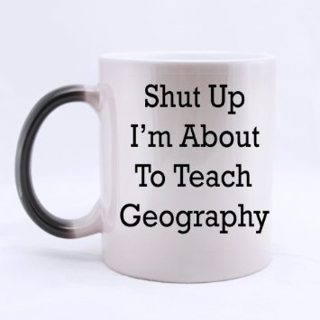
Map Items on SIM
Alaska
Nigeria
Niger River
Azerbaijan
Caucasus Mountains
Armenia
Georgia
Chechnya
Russia
Kuwait
Strait of Hormuz
Strait of Gibraltar
Strait of Malacca
Bab el-Mandab
English Channel
Bosporus
Dardanelles
Panama Canal

Slide 4
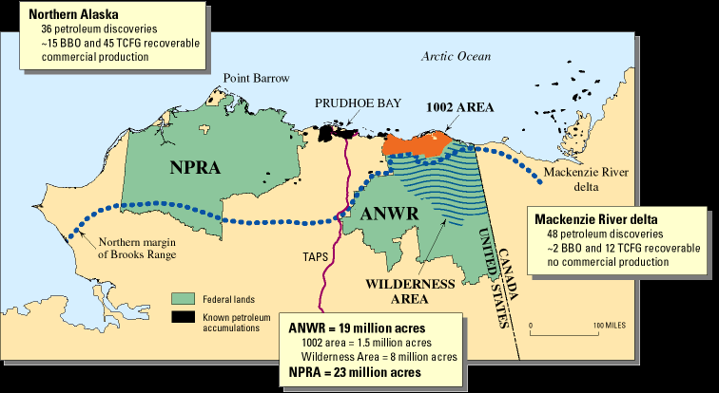
Vocabulary
ANWR(Arctic National Wildlife Refuge) – Northeastern Alaska, established in 1960 to preserve unique wildlife, wilderness and recreational values. In 1980, re-designated and provided four purposes that guide management of the entire Refuge: to conserve animals and plants in their natural diversity, ensure a place for hunting and gathering activities, protect water quality and quantity, and fulfill international wildlife treaty obligations.
Just so happens to have a potential for large oil field

Slide 5
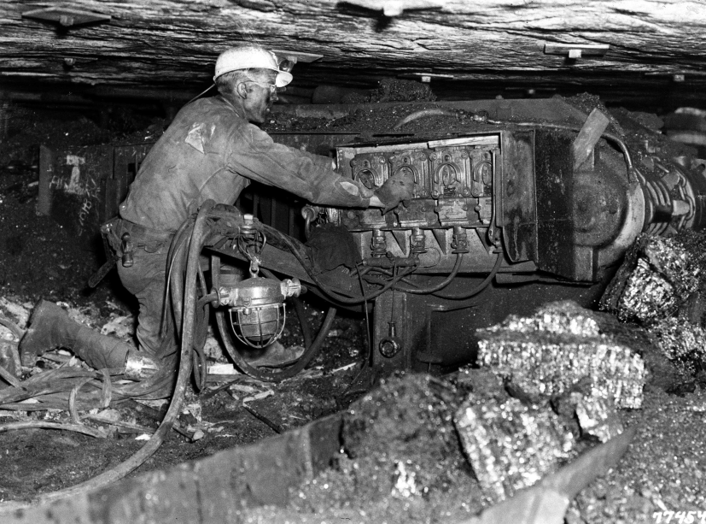
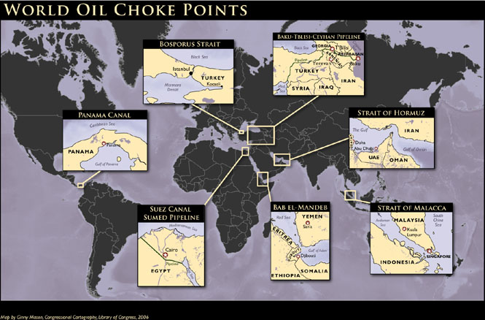
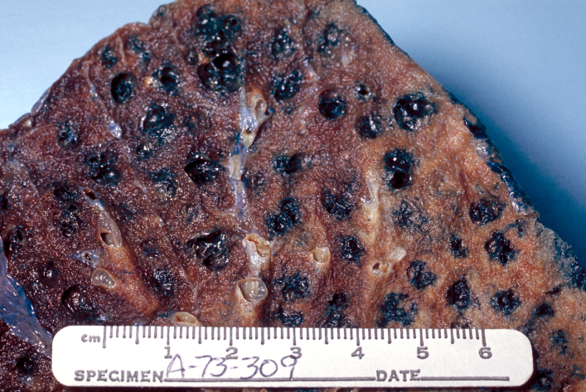
Vocab. Continued
Choke Point – narrow waterway between 2 large bodies of Land.
Country that controls choke point can dictate trade.
Black Lung – Disease, result of inhaling coal dust over long periods of time.

Slide 6
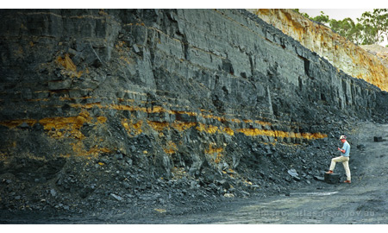
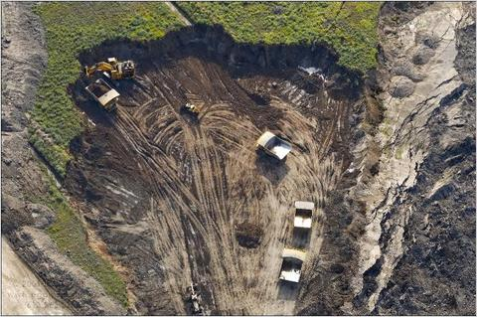
Vocab.
Coal Seam – a bed of coal usually thick enough to be profitably mined
Close to Earth’s surface
Overburden – surface that has been cleared in order to reach the coal deposits.

Slide 7
Political Cartoon Analysis
What would you title this?
What statements can be made about drilling and the environment?
Complete IR-34

Slide 8
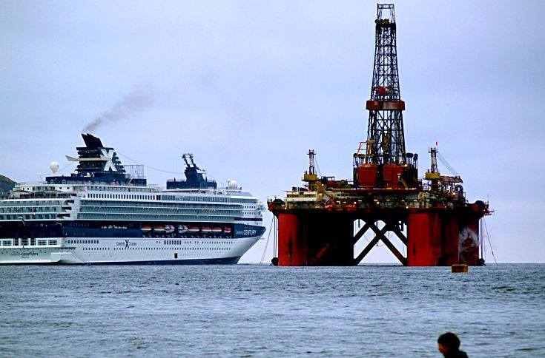
Class Discussion Fill in IR-36

Slide 9
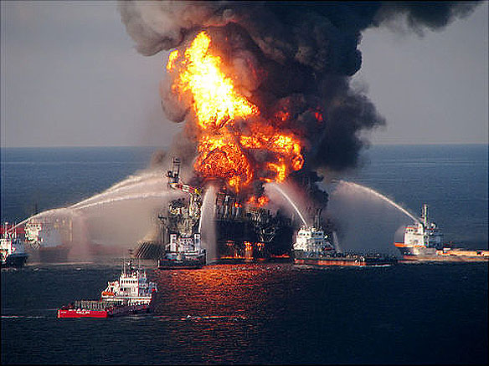
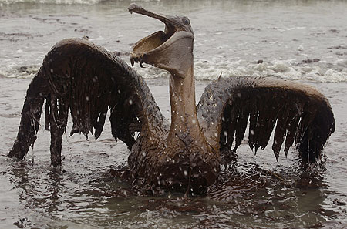
Class Discussion Fill in IR-36

Slide 10
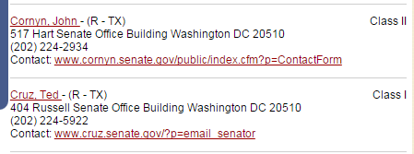
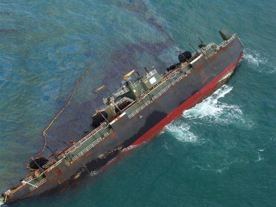
Letter to My Senator
Using Reading from IR-37 & Rubric from IR-38 write a letter to a US Senator either supporting or criticizing continued oil production.

