Slide 1
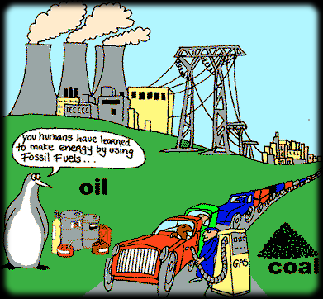
Economic Geography & Development
Unit 2 Lesson 7
Fossil Fuels

Slide 2
Essential ?’s
What are Fossil Fuels & how are they used throughout the world?
What is a spatial distribution of the major known petroleum and oil fields?

Slide 3
Map Items on SIM
Persian Gulf
North Sea
Gulf of Mexico
Venezuela
Western Russia
Gulf of Guinea
South China Sea
Siberia
United States
Brazil
Canada
Australia
Sweden
Estonia

Slide 4
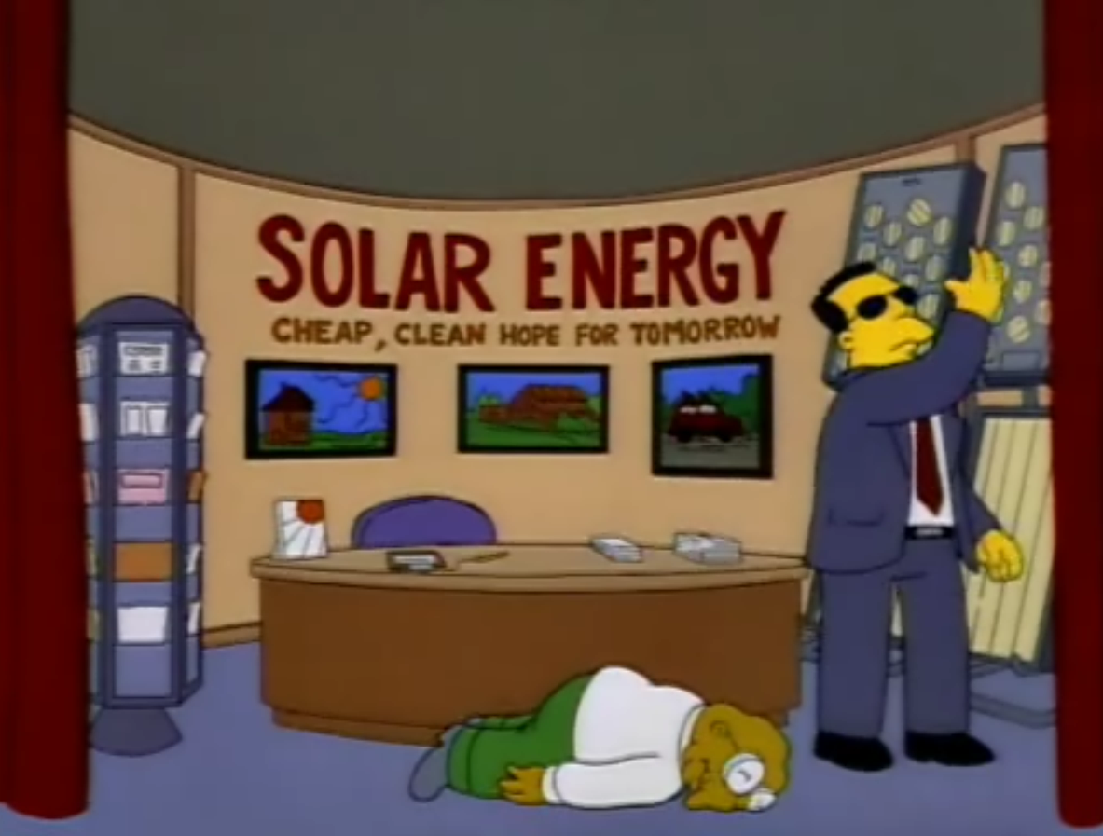
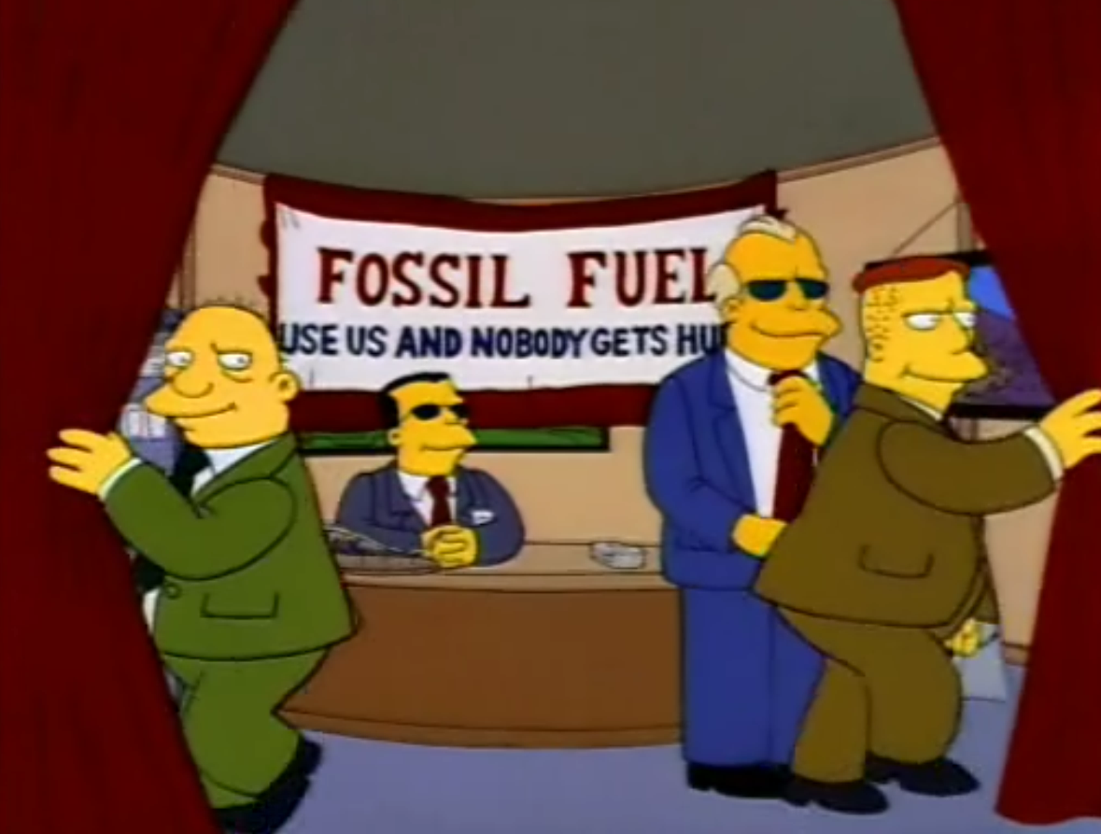
Yes, No, or Possible Maybe? Before & After Reading
The largest know oil field in the world is located in Iraq.
Extracting oil shale requires more time and money than refining crude oil.
Coal accounts for 30% of the world’s energy.
Fossil fuels are nonrenewable sources of energy.

Slide 5
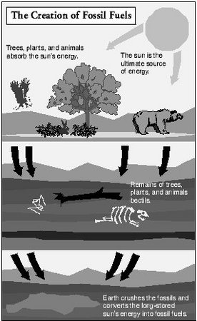
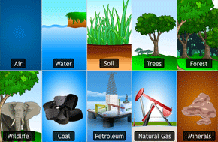
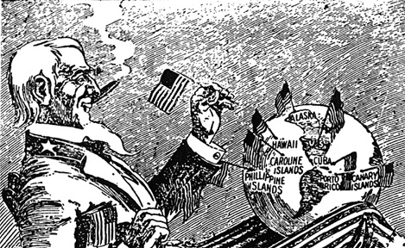
Vocabulary
Resource
Anything that people need & have assigned a value to.
Imperialism
A policy of extending a country's power and influence through diplomacy or military force
Primarily for economic reasons
Fossil Fuel
Created after dead plants & animals have been buried and compressed for millions of years
Crude Oil, Natural Gas, Coal
http://www.bing.com/videos/search?q=oil+fields+of+the+world&FORM=HDRSC3&adlt=strict#view=detail&mid=5D61FCB92A3EF4C04DFB5D61FCB92A3EF4C04DFB

Slide 6
Political Cartoon
What would you title this cartoon?
What are 2-3 value statements that generalize America’s view on oil and oil consumption?
What are your views?
Begin IR-29 Political Cartoon Analysis

Slide 7
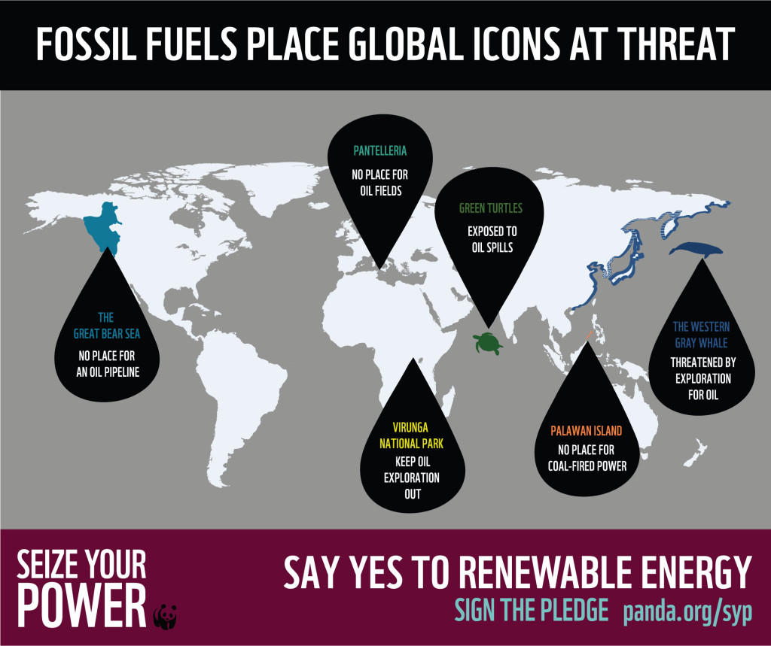
Reading Time ☺
Use Reading from IR-31 to complete IR-30

Slide 8
Use to complete IR-32 Map
1.Which Countries consume the most oil.
2.What impact does the control of the waterways play in oil consumption?
3.What inferences can be made from this chart?

Slide 9
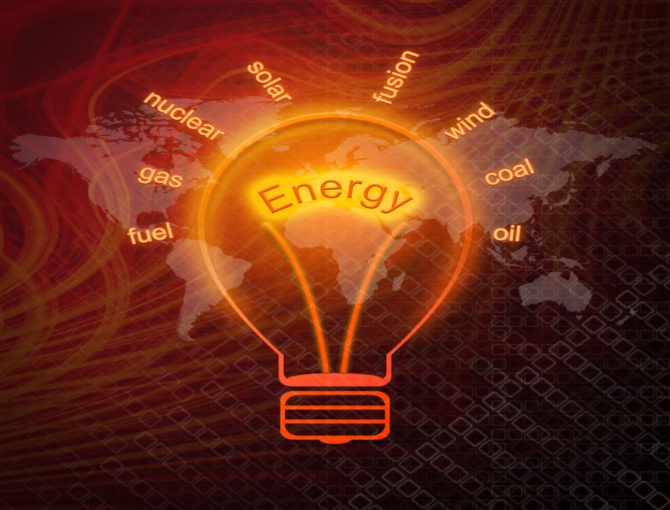
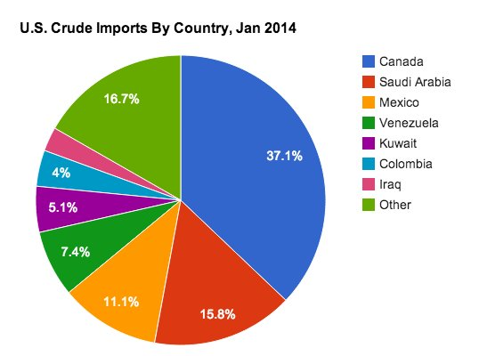
Geographer Journal Writing
1. Why do so many countries use oil and natural gas instead of wind, solar, and nuclear energy as primary sources of energy?
2. Why does the United States import so much oil and natural gas instead of drilling and producing its own?

Slide 10
Geographer Journal Writing Continued
3. Although there is not a major oil field in Houston, Texas, it is called the “Energy Capital of the World.” Why is that true?

