Slide 1
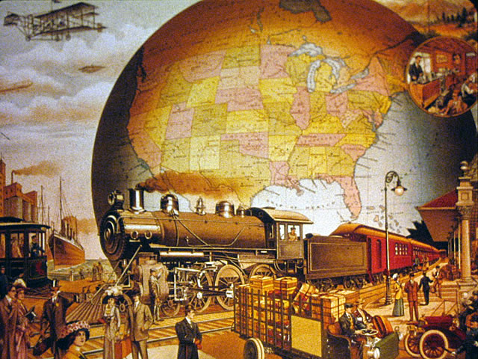
Economic Geography & Development
Unit 2 Lesson 3
Industrialization

Slide 2
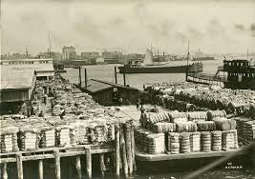
Essential ?’s
How did the physical geography of England contribute to the development of the Industrial Revolution?
What is the significance of the spatial relationship between the European colonial claims throughout the world and the industrial and manufacturing cores of today?

Slide 3
Map Items on SIM
Birmingham, England
Wales
Ruhr Valley
Germany
United States
China
Chernobyl, Ukraine
London, England
France
Netherlands
Portugal
Spain
Burma
India
Hong Kong
Malaysia
Singapore
Botswana
Egypt
Kenya
Nigeria
Sudan
Cambodia
Laos
Vietnam
Algeria
Mali
Morocco
Niger
Belgium
Congo
Angola
Mozambique
Philippines
Western Sahara
Western Europe
Central Europe
Northeastern North America
Russia
Eastern Asia
Canada
United Kingdom
South Korea
Taiwan
Mexico
Brazil
Tijuana, Mexico
Ciudad Juarez, Mexico
Nuevo Laredo, Mexico
Matamoros, Mexico
Caribbean Islands
Guatemala
Honduras
Thailand
Indonesia

Slide 4
Vocabulary
Industrialization – a shift in the economy from farming to manufacturing by machines.
Land – (Factor of Production) Owning land means owing all the resources on or in the land.
Labor – (Factor of Production) The people who preform different economic activities & people who transport goods from one place to another.
Capital – (Factor of Production) Refers to money.
http://www.history.com/topics/industrial-revolution

Slide 5
Vocab. Cont…
Entrepreneurship – (Factor of Production) People who accept the risk to start and run their own business.
Deindustrialized – Highly developed economies such as US, UK, & Japan have shifted away from manufacturing & toward Tertiary and Quaternary Sector work.
Developed
Shifting
Tertiary & Quaternary Sector
Outsourced – Companies in developed countries hire workers in emerging countries to preform work at less cost than would be possible in the US.
Developing
Manufacturing
Secondary Sector
Maquiladoras – Foreign-owned factories in Mexico operate in cities near the US border & mass-produce goods @ less cost than would be possible in US.
Border Cities
Foreign-owned
Exporting

Slide 6
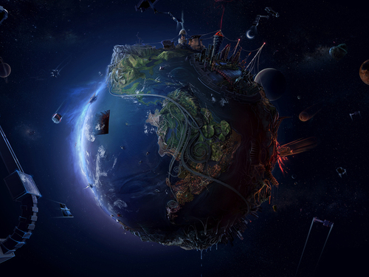
Complete IR-11 using PPT

Slide 7
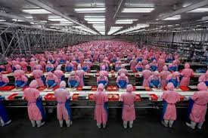
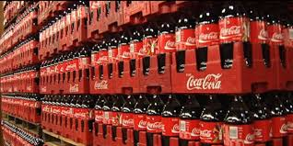
Industrialization
Factories
Production
Efficiency
Technology
Mass Production

Slide 8
Factors of Production
Land
Resources
Soil
Water
Natural resources
Labor
Jobs
Workers
Producers
Capital
Purchase
Pay
Invest
Entrepreneurship
Owner
Risk taker
Inventor
Creator

Slide 9
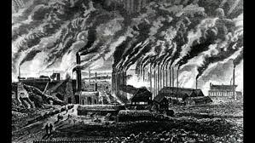
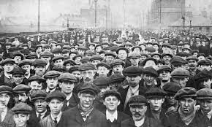
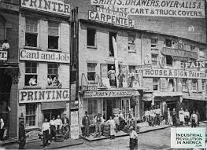
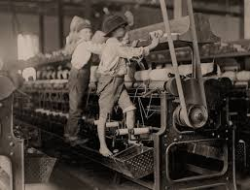
Industrial Revolution
1750, Great Britain
All 4 Factors of Production available
Birmingham, England
Water power & Coal fields provide energy for machines
Growing Population
Plenty of workers

Slide 10
Resources used for Energy
1700’s
Coal
England & Whales
Ruhr Valley – Germany
Eastern USA
China
Exploited resource
Inexpensive to mine but damages the physical environment
Present Day
Oil & Natural Gas
Cheaper to extract, refine & use
Nuclear Energy
Cleaner burning & less negative impact on environment than fossil fuels
Mass Production of Nuclear Energy Limited
Nuclear incident
Radioactive waste

Slide 11
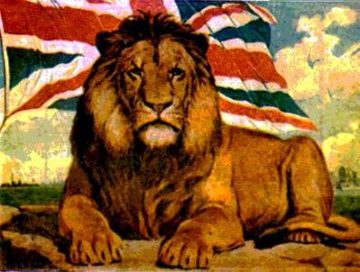
European Colonies
European exploitation of natural resources in distant lands provided jobs in homeland to maintain lifestyle & established markets in other countries to sell goods & services.

Slide 12
World Since 1750
Similarities
Differences
Need for Countries to interact with each other.
Wallerstein’s World System Theory – examines spatial relationship of 4 major industrial & manufacturing cores in the world
Western & Central Europe
Eastern North America
USA & Canada
Russia & Ukraine
Eastern Asia
More:
People in Urban areas
People working in Secondary & Tertiary Sector
Technology that changes our daily activities

Slide 13
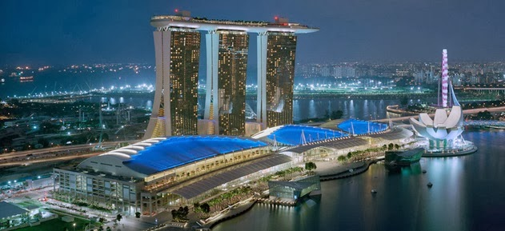
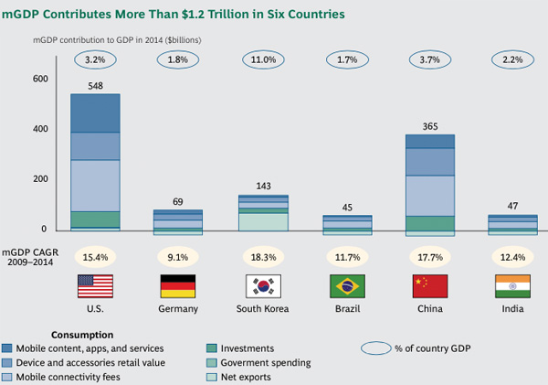
More Developed Countries
High GDP – Gross Domestic Product
High Literacy Rates
Longer Life Expectancy
Greater access to technology
Infrastructure
Educational & Medical facilities
United States & Canada
Abundance & variety of Natural Resources
Created worlds most sophisticated industrial complex in very little time
Extensive trade network with countries for energy resources
Neither sustained human causalities & environmental degradation of WWI & II
Japan, United Kingdom, France & Germany
Able to rebuild economy with US assistance after WWII

Slide 14
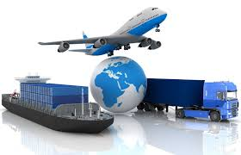
Newly Industrialized Countries
Rapidly developed in recent years, economies may not be as stable but continue to thrive
South Korea, Taiwan, & Singapore
Hong Kong – no longer independent economic entity since British released control & converted to Chinese control in 1997
China, India, Mexico, Brazil, & Russia
Strong trading relationship with More Developed Countries

Slide 15
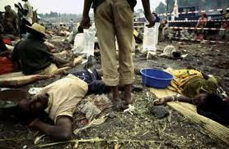
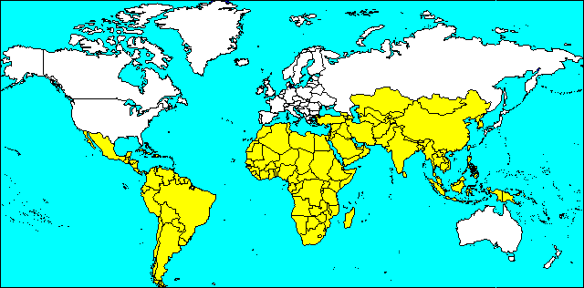
Less Developed Countries
Non-industrialized or Third World Country
Low standard of living & low income
High Poverty
Little or No Infrastructure
Transportation, communication, sewage, water, electricity

Slide 16
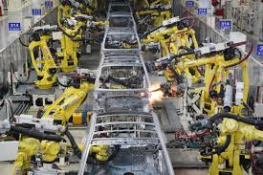
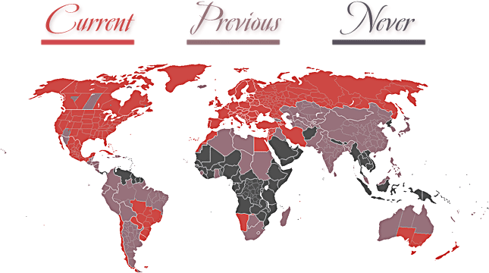
Deindustrialized Countries
Shifting core economic processes away from industry Secondary Jobs – assembly line, manufacturing, & industrial
United States, United Kingdom, & Japan
Higher per capita income because the Tertiary & Quaternary sector jobs pay higher than secondary jobs

Slide 17
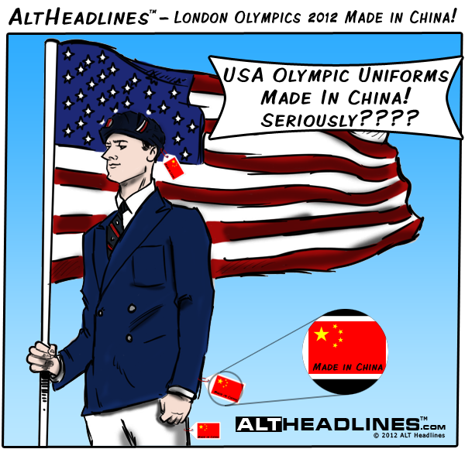
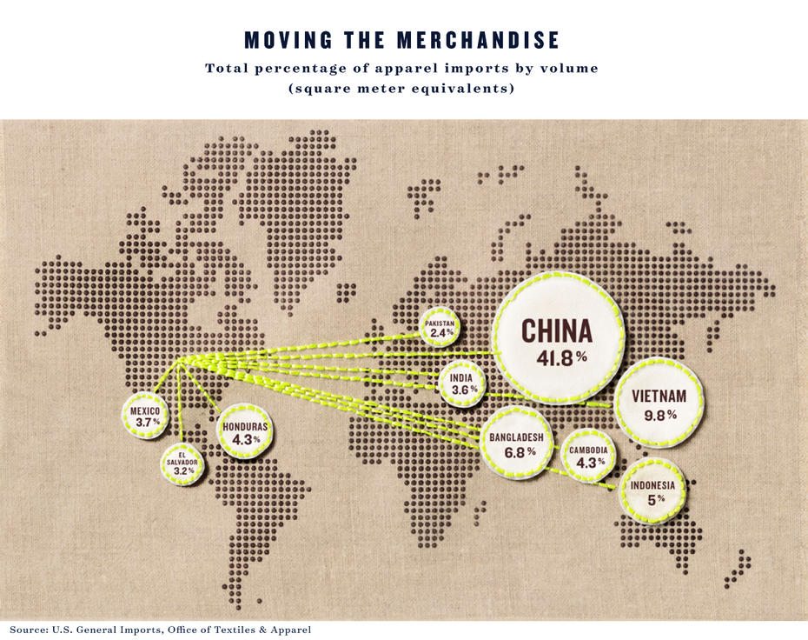
Outsourced Countries
Have Developing economies
China produced American goods as a means of developing
Maquiladoras – foreign owed factories in Mexico that employ thousands of people who mass produce clothing, automobiles, & toys
Tijuana, Ciudad Juarez, Nuevo Laredo, Matamoros, & Mattel
No labor laws & regulations like USA so workers receive less pay & dangerous working conditions
Outsourcing is not specific to places or jobs
Primary Sector Jobs
Caribbean islands = fruit & sugar
Indonesia & Southeast Asia = spices
Western Africa = cocoa bean for chocolate
Secondary Sector Jobs
Guatemala, Honduras, Vietnam, Thailand, & Indonesia = clothing manufacturing
Most interesting outsourcing in Tertiary Sector
Call center jobs in India
More people with college education
Economic sense for companies to pay lower wages to maximize profits that outsourcing allows

Slide 18
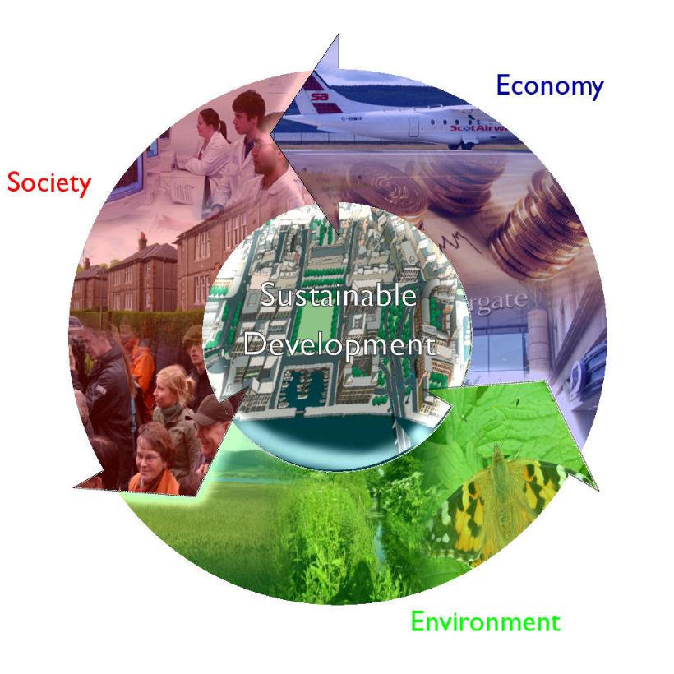
Sustainable Development
Development that meets the needs of the present without compromising the ability of future generations to meet their own needs
World Commission on Environment & Development in 1987
Idea that all human beings would be able to live a safe & satisfying life without mortgaging environmental conditions for future generations
1.3 billion people don’t have access to clean water
20% of wealthiest people control 86% of world wealth
1billion suffer hunger = 1 billion obese
3billion people survive less than$2
United Nations Division of Sustainable Development & world Business Council for Sustainable Development
Organizations trying to increase knowledge, break down stereotypes, & increase discussion on ways to improve living conditions for all people including future generations
Disagreements
What sustainable development is?
Who controls development?
Disguise to influence population control!!

Slide 19
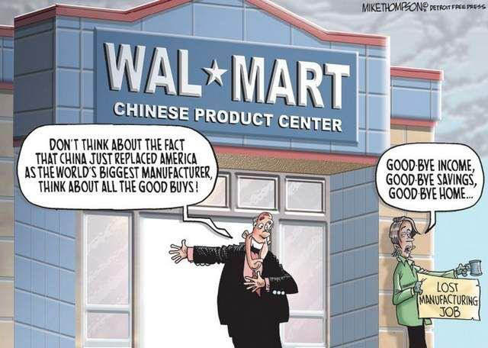
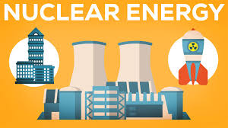
In Small Groups Complete IR-13
Problems:
Coal Exploitation
Nuclear Energy
Outsourcing Jobs
Use details from IR-12

