Slide 1
Economic Geography & Development
Unit 2 Lesson 6
European Union & NAFTA

Slide 2
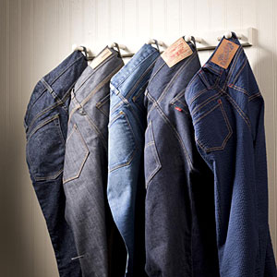
The Price is Right!?!
Predict the amount for these items in:
US Dollars
Mexican Pesos
European Euros

Slide 3
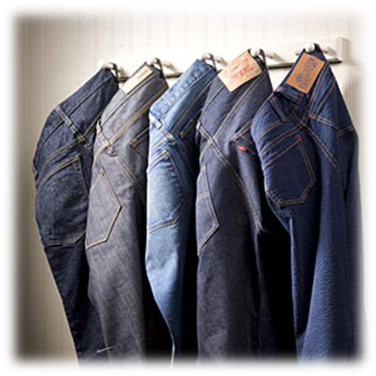
Dollars = $50
Pesos = $609.60
Euros = C37.36
US = $20,000
Mexico = $243,840
Europe = C14,943.20
US = $45
Mexico = $548.64
Europe = C33.62
Dollars = $10
Pesos = $127.32
Euros = C7.61
US Dollars = $400
Mexican Pesos = $5,091
European Euros = C304.31

Slide 4
Essential questions
What has been the relative success of the European Union? (Provide support for your answer) https://www.youtube.com/watch?v=j8sYjQDUhKM
What has been the relative success of NAFTA? (Provide support for your answer)
https://www.youtube.com/watch?v=LaMCK-Sec7Y

Slide 5
Map Items on SIM
Luxembourg
Macau
Norway
Singapore
United States
Ireland
Hong Kong
Switzerland
Netherlands
Austria
Sweden
Iceland
Denmark
Canada
Australia
Germany
United Kingdom
Finland
Belgium
Japan
France
Democratic Republic of Congo
Burundi
Liberia
Guinea-Bissau
Eritrea
Niger
Central African Republic
Sierra Leone
Timor-Leste
Togo
Malawi
Ethiopia
Mozambique
Rwanda
Madagascar
Nepal
Mali
Burkina Faso
Uganda
Comoros
Haiti
Italy
Shina
Russia
Turkey
Mexico
Tijuana, Mexico
Ciudad Juarez, Mexico
Nuevo Laredo, Mexico
Matamoros, Mexico

Slide 6
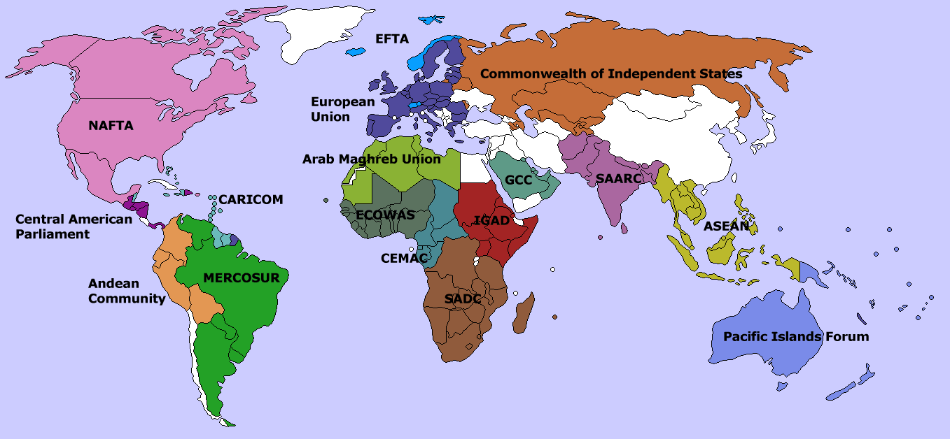
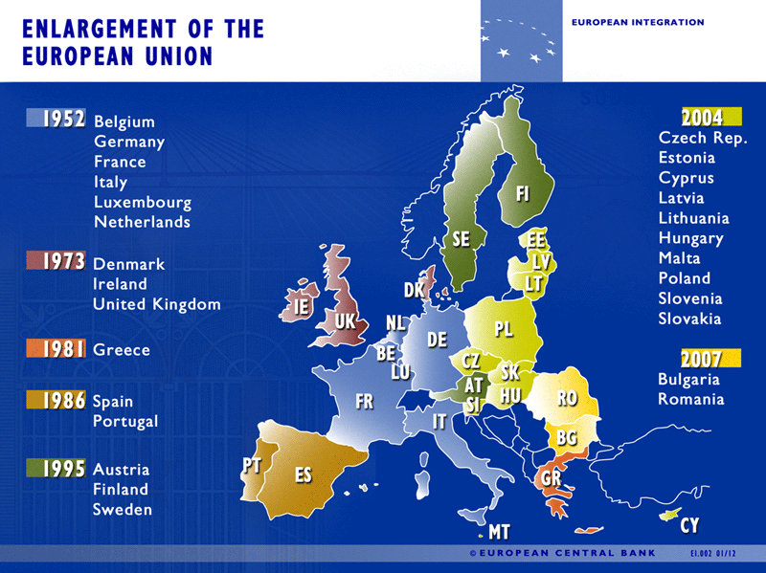
Vocabulary
Supranational Organization – involves 3 or more countries that have a shared economic, cultural, and/or political policy objectives and are willing to operate as a single organization.
ECSC – European Coal & Steel Community – created by 6 European countries in 1948 to manage each country’s coal & steel industries.
Belgium, France, Germany, Italy, Luxembourg, & the Netherlands
Very Successful
European Economic Community – 1957 ECSC expanded to other industries – created “common market” allowed people, goods, & services to move freely between member countries without taxes.

Slide 7
more Vocabulary
Supranational Organization – involves 3 or more countries that have a shared economic, cultural, and/or political policy objectives and are willing to operate as a single organization.
ECSC – European Coal & Steel Community – created by 6 European countries in 1948 to manage each country’s coal & steel industries.
Belgium, France, Germany, Italy, Luxembourg, & the Netherlands
Very Successful
European Economic Community – 1957 ECSC expanded to other industries – created “common market” allowed people, goods, & services to move freely between member countries without taxes.

Slide 8
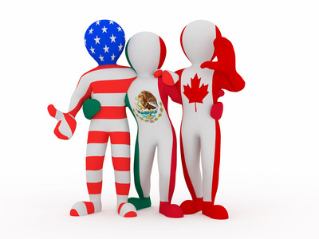
Vocab. Continued ☺
European Union(EU) – committed to democracy, the rule of law, peaceful relationships @ home & abroad, & respect for human rights.
More than 25 member countries
Came from Maastricht Treaty in 1992
Euro – common currency shared by members of EU, helps economically:
Travelers don’t have to stress over exchange rates for different countries
NAFTA – North American Free Trade Agreement – trade agreement between Canada, USA, & Mexico.

Slide 9
Work Time!!! ☺ Use Chart to complete IR-23

Slide 10
Complete IR-25/26/27 With Reading from IR-24

