Slide 1
URBANIZATION
Unit 3 Lesson 7: Texas Core

Slide 2
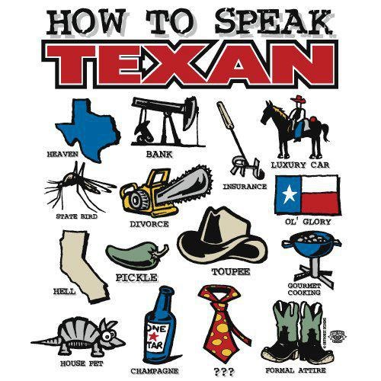
ESSENTIAL ?’S
What are the defining characteristics of the Texas urban core?
What are the nicknames of each nodal city of the Texas urban core, and how did each city get that name?

Slide 3
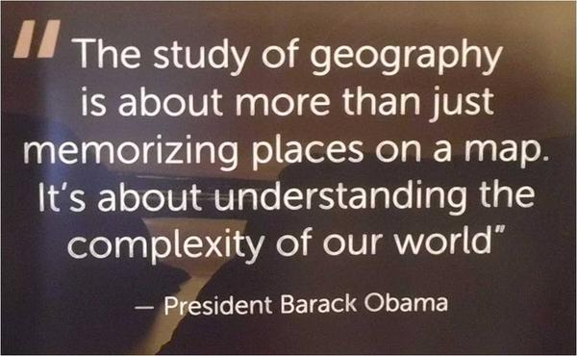
MAP ITEMS ON SIM
Dallas
Fort Worth
Houston
Baytown
Huntsville, Texas
San Antonio
Kansas City, Missouri
Chicago, Illinois
Trinity River
Lewisville
The Colony
Frisco
McKinney
Mexico
Guatemala
Panama
Colombia
Venezuela
Vietnam
Korea
China
Japan
Taiwan
El Paso

Slide 4
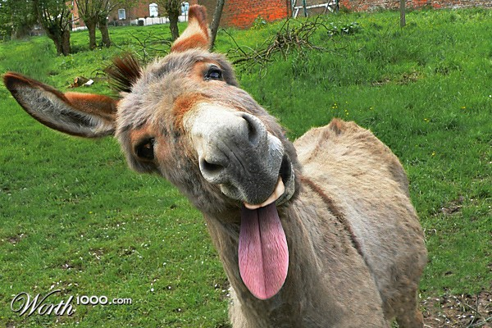
NO VOCAB☺

Slide 5
CLASS DISCUSSION
Can you identify:
The border of Texas
Major cities in Texas
Major roads in Texas
How were you able to identify borders , cities, and roads of Texas?
What additional information would you like to have to read this map?

Slide 6
MAPPING THE TEXAS CORE: IR-28
Part A
Label
Davis Mountains
Edwards Plateau
Balcones Escarpment
Gulf Coastal Plains
Llano Estacado
Balcones Escarpment

Slide 7
MAPPING THE TEXAS CORE: IR-28
Part B
Label
Austin
Arlington
Corpus Christi
Dallas
El Paso
Fort Worth
Garland
Houston
Lubbock
San Antonio
Garland

Slide 8
WORK TIME ☺
Complete Parts C-E on IR-28
Using Reading from IR-30

