Slide 1
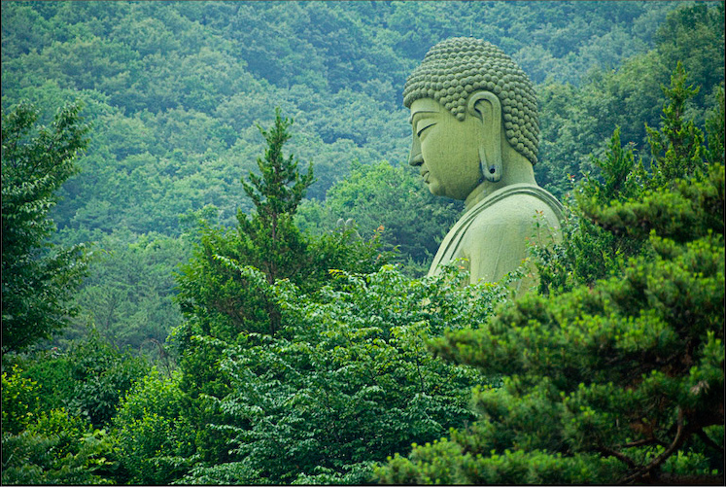
The Physical World
Unit 1 Lesson 9
Resources

Slide 2
Essential ?’s
How do humans determine the inherent value of any resource?

Slide 3
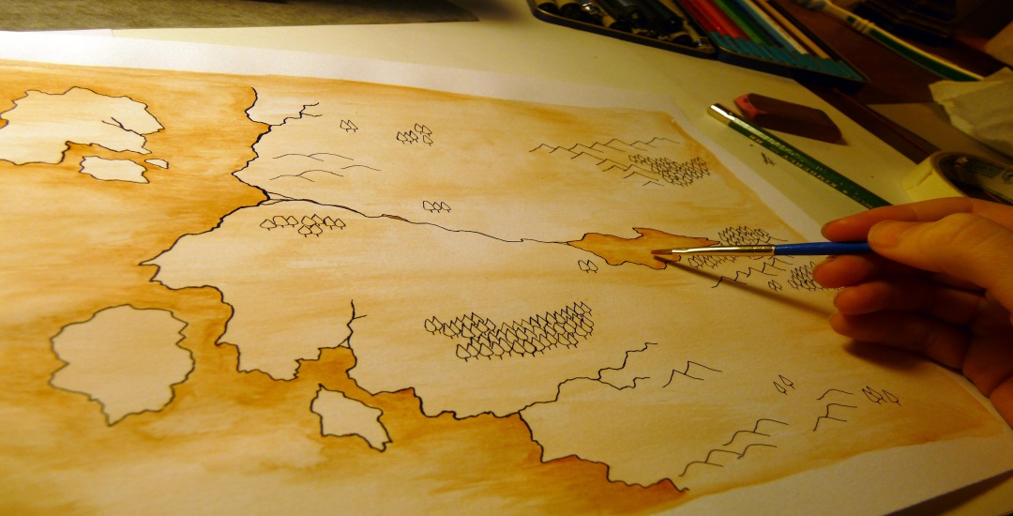
Map Items on SIM
Tibet
Ethiopia
Persian Gulf
Gulf of Guinea
North Sea
Bay of Campeche
Venezuela
Saudi Arabia
Kuwait
Iran
Mexico

Slide 4
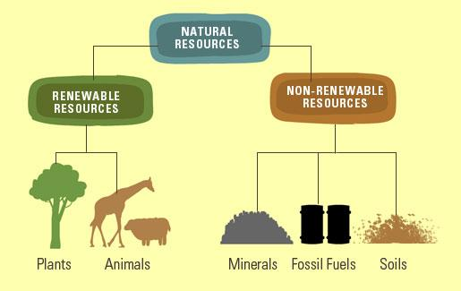
Vocabulary
Human Resources – refer to human beings as a source of labor and intuition.
Thinking, Planning, Building
Natural Resources – things that occur in the natural or physical world.
Oil, Coal, Soil, H2O, Air
Resource – anything that people need and to which they have assigned a value.

Slide 5
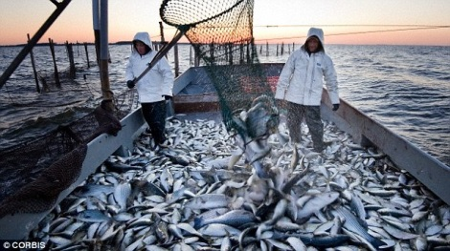
Class Discussion
In Groups:
Identify – all the natural resources in the USA
What factors influence where resources are located?
How do resources affect where people live?

Slide 6
Group Work
Organize the Resource Card cutouts
Be able to Justify your reason of patterns
Discussion
Why did you chose the structure you used?
What do these things have in common?
How are they different?

Slide 7
Work/Writing Time
Complete IR-25
Using Reading from IR-26
In Geographer Journal respond to the following prompt:
You work in an oil field. Production on your current oil well will stop in 6 months. Write a letter to your boss explaining the situation and its effects on the company and the location where the oil will exists.
2 paragraphs include voacb. learned.

