Slide 1
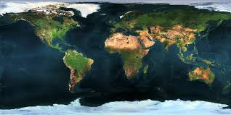
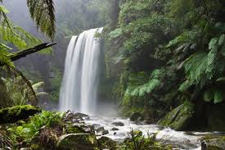
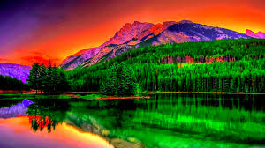
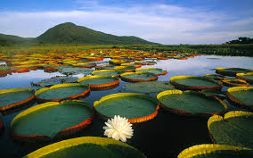
The Physical World
Unit 1 Lesson 6
Water

Slide 2
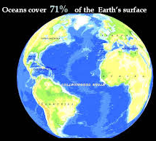
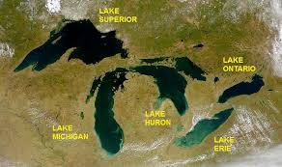
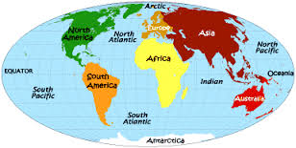
Essential ?’s
What is Physical Geography?
How much of Earth is covered by water?
Why do all people Not have access to freshwater?

Slide 3
Map Items on SIM
Gulf of Mexico
Caribbean Sea
Artic Ocean
Atlantic Ocean
Indian Ocean
Pacific Ocean
Southern Ocean
Lake Erie
Lake Huron
Lake Michigan
Lake Ontario
Lake Superior
Latin America
North Africa
Middle East
South Asia

Slide 4
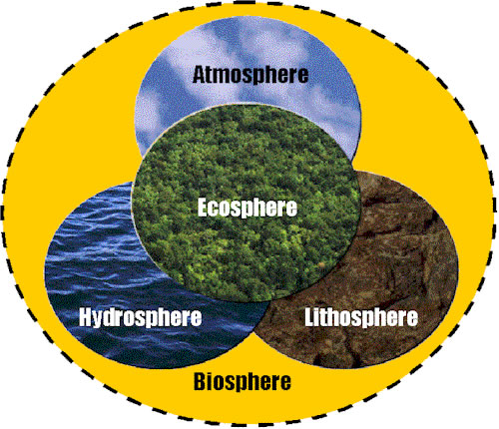
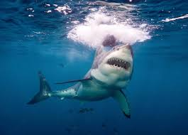
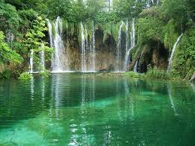
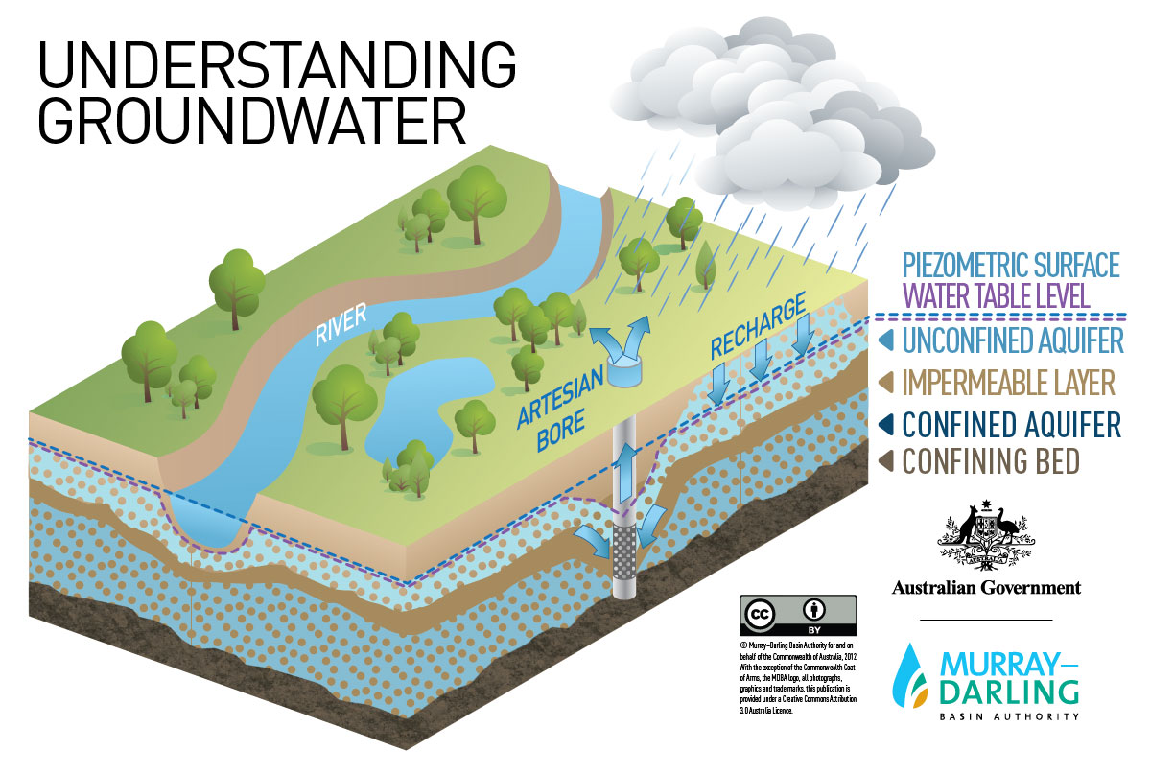
Vocabulary
Water hemisphere – 71% of Earth’s surface.
Biosphere – ecosystem of ALL living organisms on Earth, need H2O to survive.
Salt Water – 97% of Earth’s water, humans can’t use
Freshwater – 3%, humans can Only use 1%. 2=Glaciers & Polar regions …. 1= Rivers, Lakes, Aquifers.
Ground Water – freshwater held in soil & pores of some rocks. Not exposed to sun & does not evaporate.

Slide 5
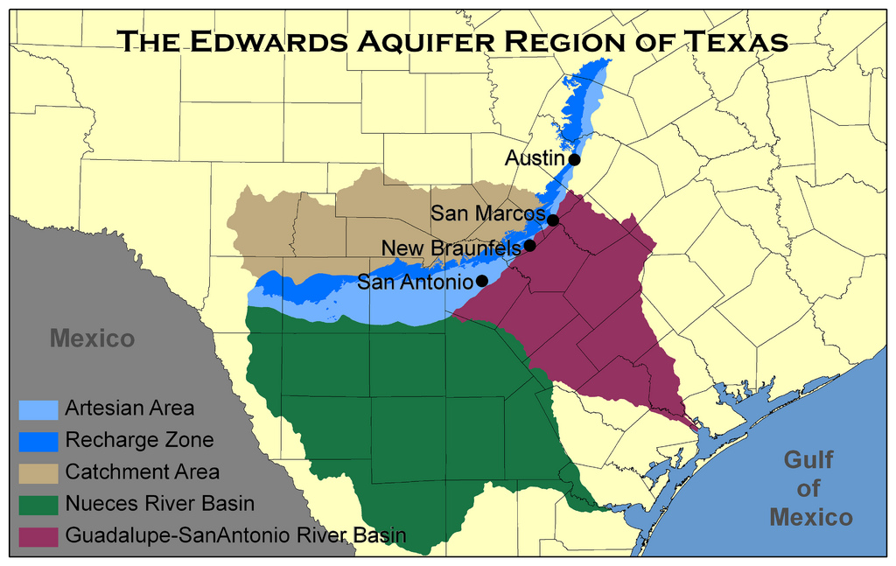
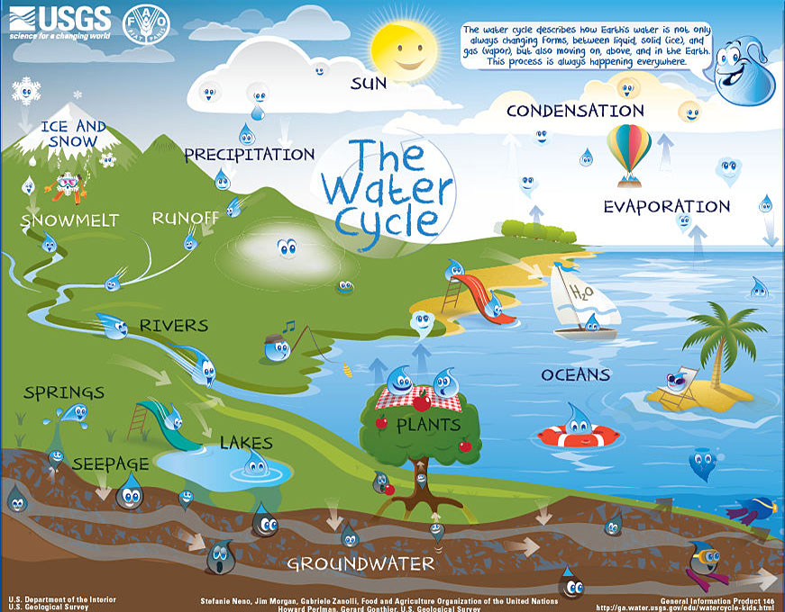
Vocab. Cont.
Aquifer – Large accumulations of groundwater. Used for drinking & land irrigation.
Hydrologic Cycle – physical process fueled by Sun’s energy.
Evaporate – H2O is gas state. Condenses in upper atmosphere & cools.
Precipitation – H2O returning to Earth’s surface… Liquid=Rain Solid=Snow, Hail, Sleet.
Scarcity – insufficient amount of H2O to satisfy human demand.

Slide 6
Bottle Water Discussion
What did you learn?
How do you feel about the small amount of drinking water?
What are some specific problems in the world that deal with access to or availability of clean freshwater supplies?

Slide 7
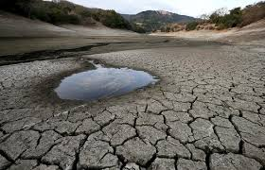
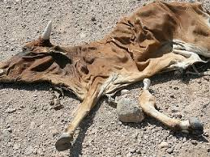
Imagine This….
Emergency!!!!
Dickinson will be experiencing a Drought for the foreseeable future! Conditions will be:
Extreme Heat
Dry Conditions
H2O Rationing Permanently
What natural resources will help us meet our basic human need in Dickinson?
How will the lack of H2O affect the population of our city?
How will the lack of H2O affect of economy?
Who in our city will be affected most by this problem?

Slide 8
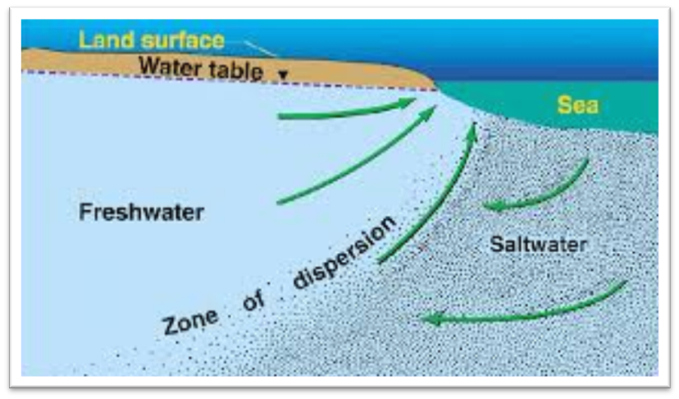
Complete IR-14 using IR-15. Please do Not write on the Class Copy ☺
Reading to Learn

Slide 9
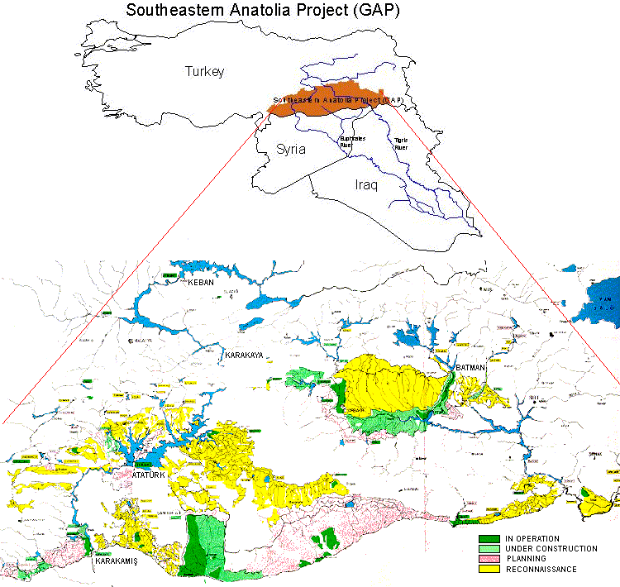
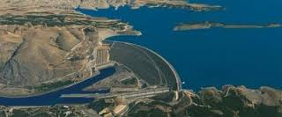
Case Study: AGREE or DISAGREE
Choose side on Southeastern Anatolia Project & debate as a class.
Geographer Journal: Write summary evaluating the geographic & economic impact of a policy related to drought conditions anywhere in the world, past/present.
https://www.youtube.com/watch?v=ipSJjVdLmJk

