Slide 1
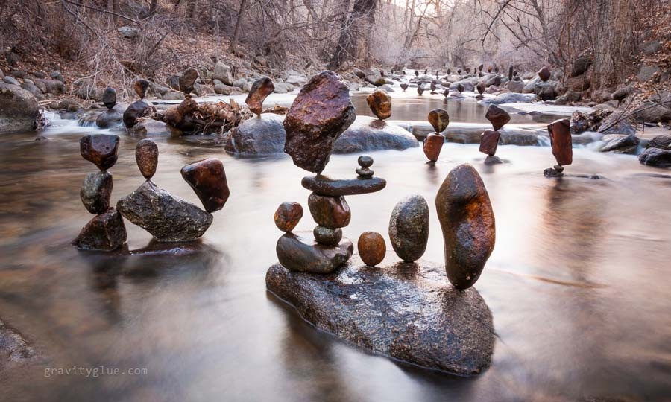
The Human Mosaic
Unit 4 Lesson 8
Cultural Landscapes

Slide 2
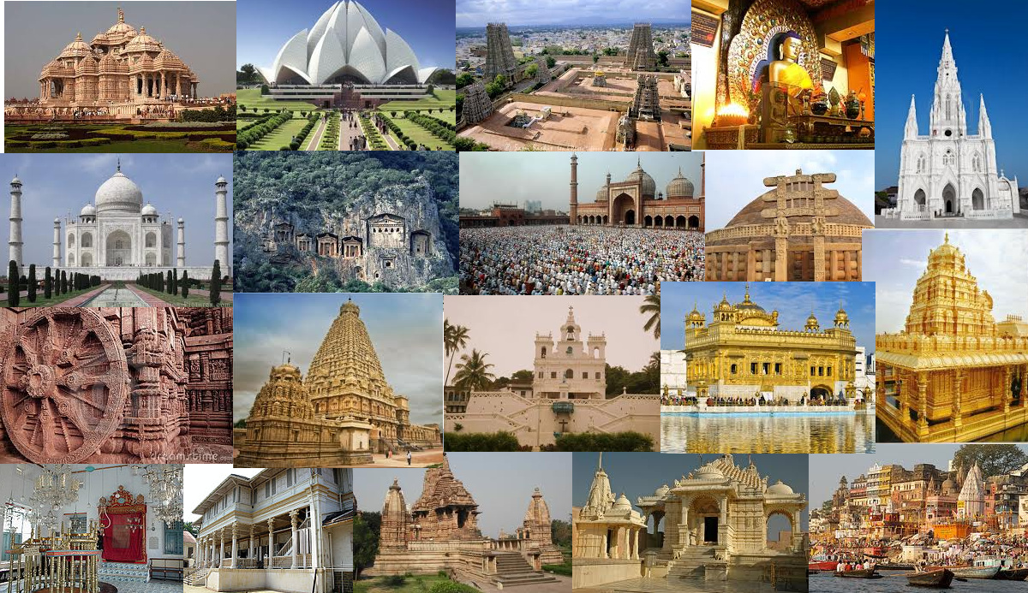
Essential ?’s
What are the general objects that make up cultural landscapes?
What are specific examples of sacred spaces in different world regions?

Slide 3
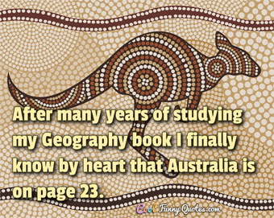
Map Items on SIM
Paris, France
New York City, New York
Egypt
China
Washington, DC.
Pretoria, South Africa
San Antonia, Texas
Houston, Texas
Agra, India
London, United Kingdom
Moscow, Russia

Slide 4
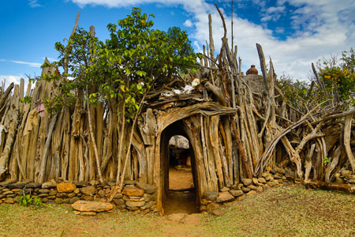
Vocabulary
Cultural Landscape – Cultural characteristics that human beings leave as an imprint of activities and objects on their physical space.
Sacred Space – An area that has a special significance & typically is worthy of devotion or loyalty.

Slide 5
Class Discussion
Where in the world are you?
Have you ever been there before?
For what is this place used?
Is this a good use of land?
Notes:
Christ the Redeemer statue, Rio de Janeiro

Slide 6
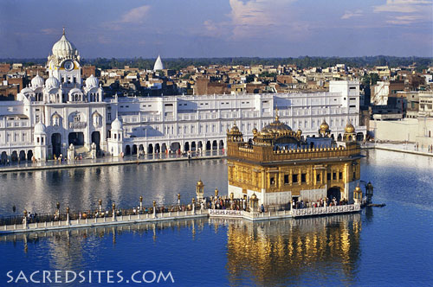
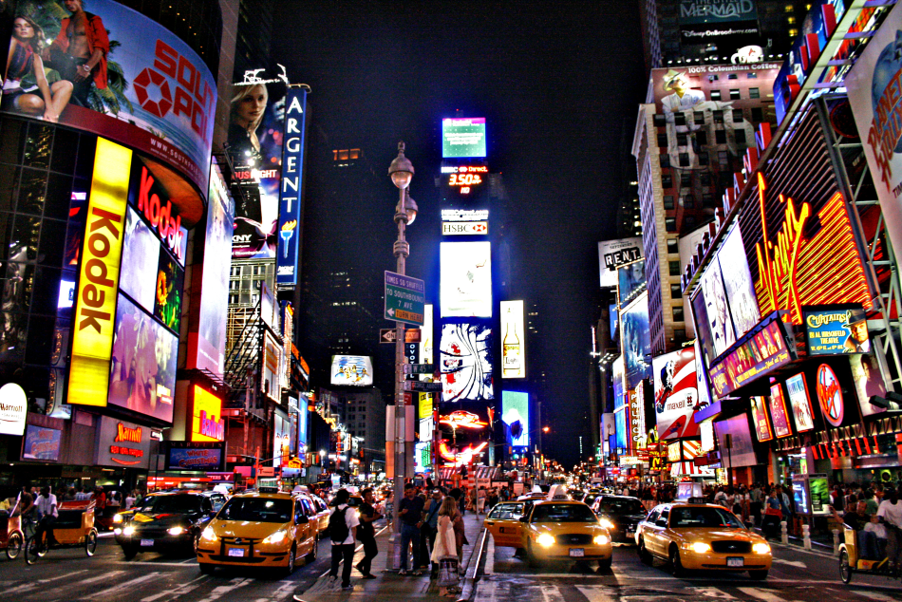
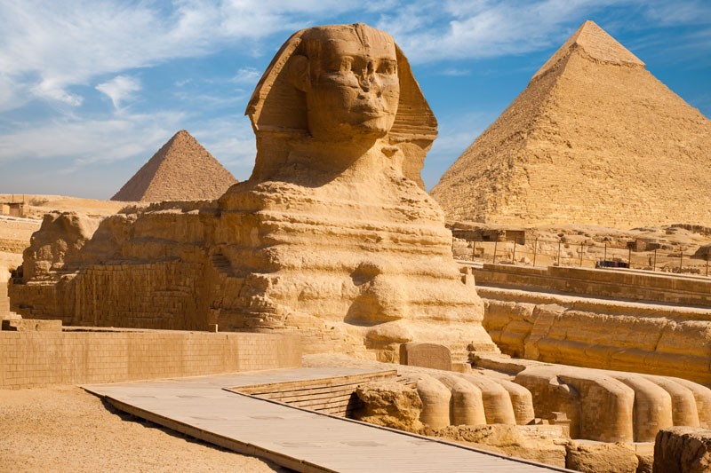
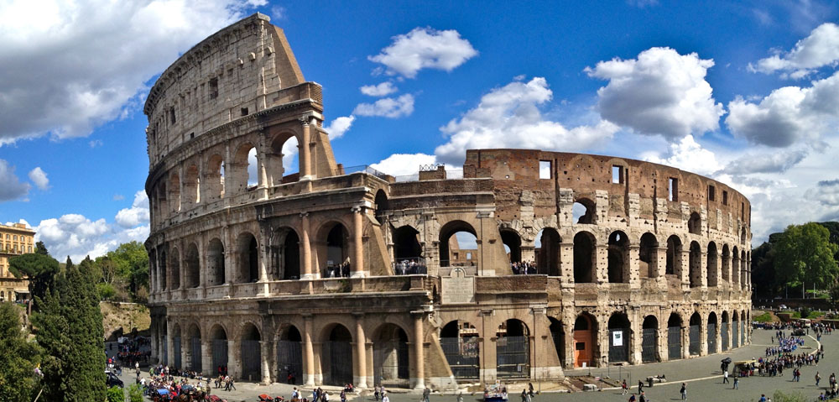
IR-35 Regional Place K-W-L
Taj Mahal: Arga, India
Golden Temple: Harmandir Sahib, India
Times Square: New York City, New York
Colosseum: Rome, Italy
The Great Sphinx & Great Pyramid: Giza, Egypt

Slide 7
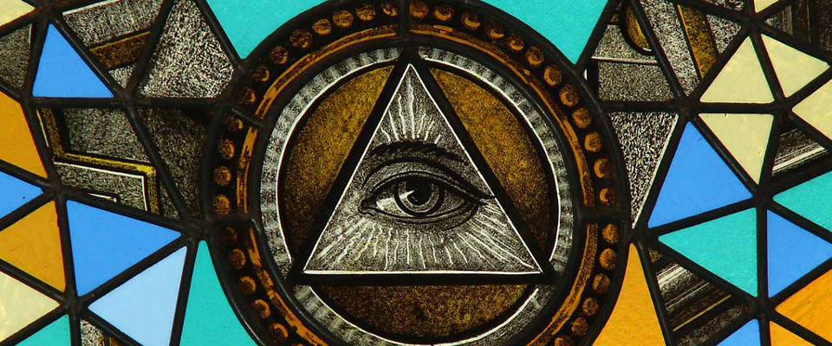
Reading Time ☺
Read IR-36 and complete Part 3 of IR-35

