Slide 1
The Human Mosaic
Unit 4 Lesson 4
Language

Slide 2
Essential ?’s
Why is being literate in one or more lingua francas beneficial?
What are the similarities of the pattern of diffusion of English and Arabic?
What are the similarities of the pattern of diffusion of Mandarin and Hindi?
Why is it important to understand the nonverbal communication cues of a language?

Slide 3
Map Items on SIM
United States
Russia
Japan
Canada
Brazil
Italy
China
Mongolia
United Kingdom
New Zealand
Australia
Thailand

Slide 4
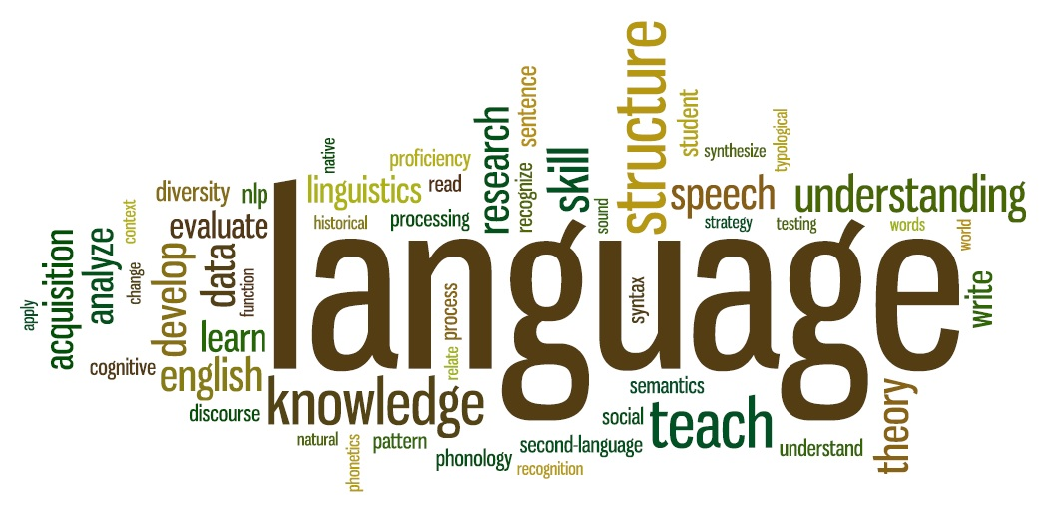
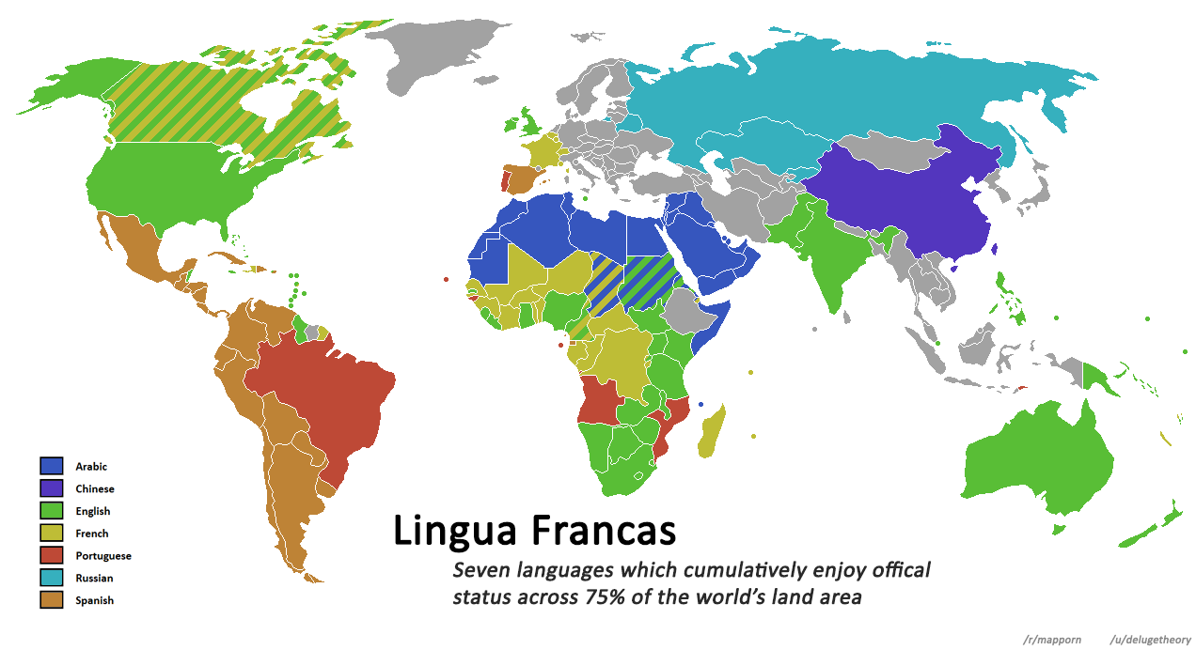
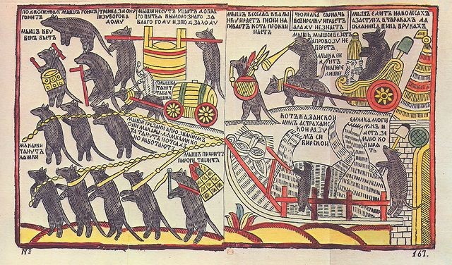
Vocabulary
Language – allows people to communicate with one another because it is a pattern of sounds that members of a society agree have the same meaning.
Literary Tradition – the written history of a cultural group.
Lingua Franca – a common language used by speakers of different language.

Slide 5
Think, Pair, Share
Identify and describe things in your life that has its own language
Provide examples of how language has become integrated with others or isolated from others.
How do languages develop?
Why do some languages remain isolated?
Why do some languages integrate with other languages?

Slide 6
Talking in Code
With a partner complete IR-14 using codes from IR-15
From where do you think text messaging originated?
What is the benefit of using this type of language?
How has text messaging changed over time?
What might be the long-term effects of using text messaging?

Slide 7
Reading Time
Complete IR-16 using reading from IR-17

Slide 8
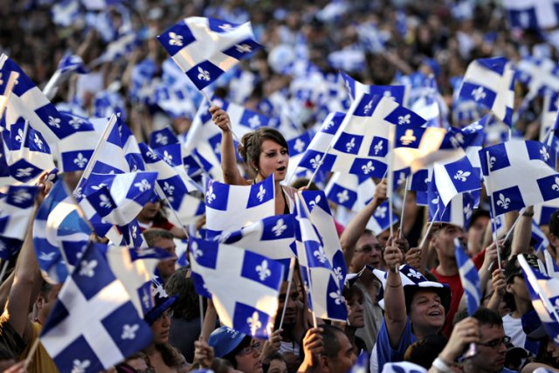
Group Case Study – The Case of the Quebecois
As a group read & discuss case study from IR-19
While completing notes from IR-18
By yourself answer IR-12

