Slide 1
Tomorrow, meet in the computer lab for class!

Slide 2
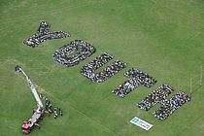
The Human Mosaic
Unit 4 Lesson 2
Cultural Regions

Slide 3
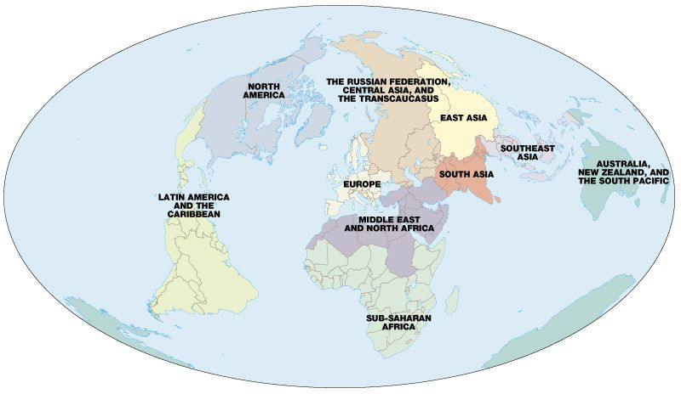
Essential ?’s
3. What are the major cultural regions of the world?
4. What are the boundaries of the major cultural regions of the world?
5. What are some unique characteristics of the major cultural regions of the world?

Slide 4
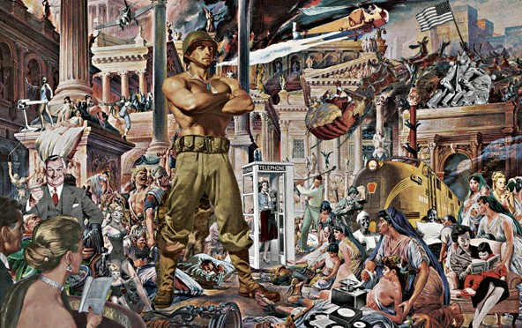
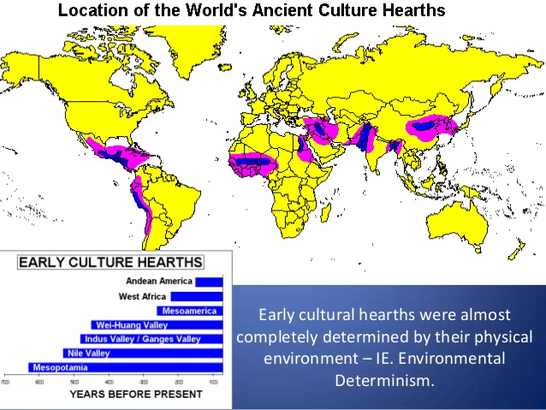
Vocabulary
Cultural Hearth – the place where a culture originated and from which it diffused.
Americana – the collective cultural traits of people from the United States.

Slide 5
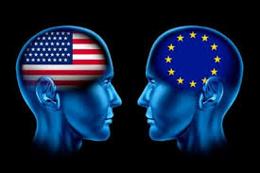
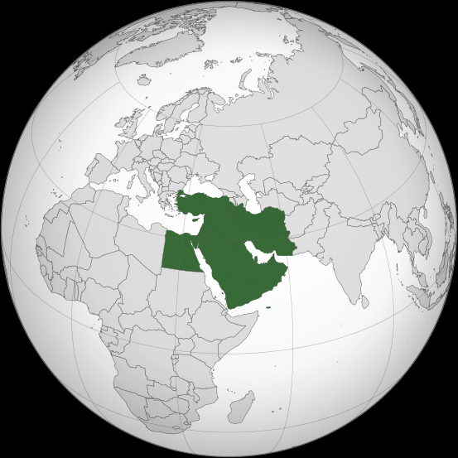
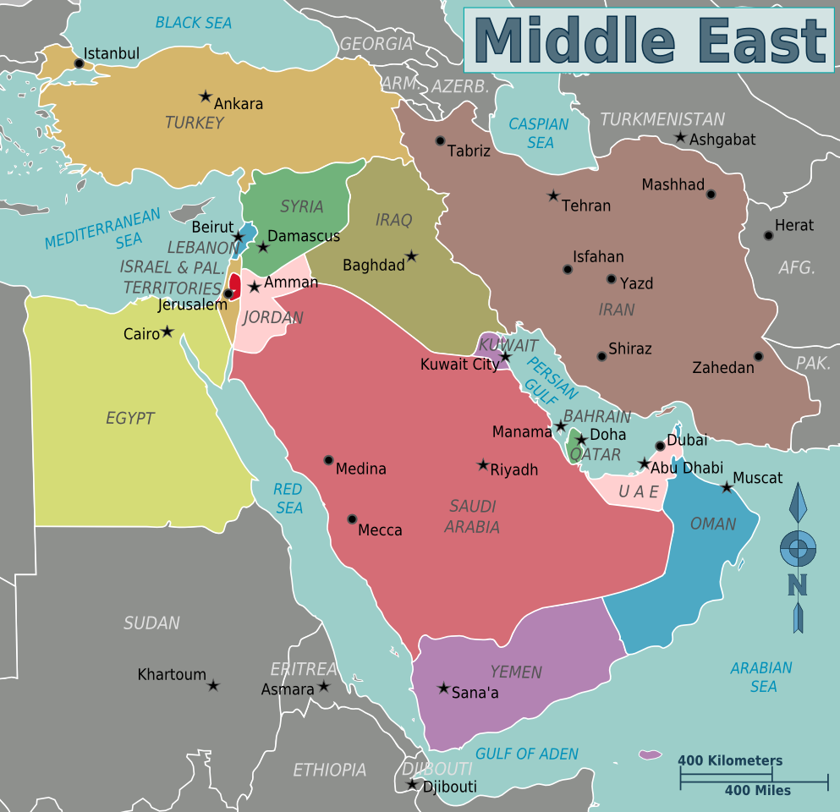
Vocab. Continued
Supranational Economic Organization - An international organization, or union, whereby member states transcend national boundaries or interests to share in the decision-making and vote on issues pertaining to the wider grouping.
Middle East - the countries of SW Asia & N Africa —usually considered to include the countries extending from Libya on the West to Afghanistan on the East
Egypt, Sudan, Israel, Jordan, Lebanon, Syria, Turkey, Iraq, Iran, Saudi Arabia, and the other countries of the Arabian peninsula.

Slide 6
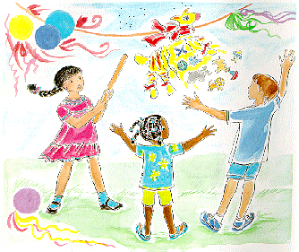
Art Work
Sketch out the 7 continents of the world
Draw lines to separate and label the regions
Western EUROPE
Eastern Europe
Middle East
South Asia
East Asia
Latin America

Slide 7
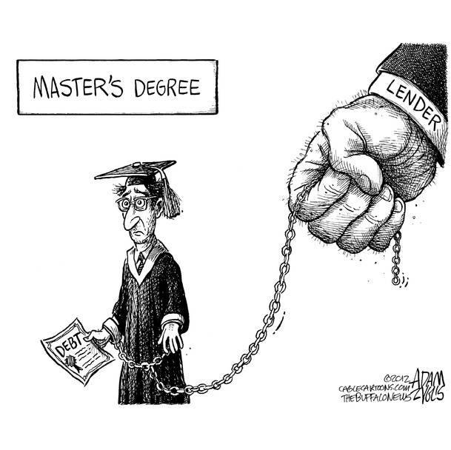
Matching Game – System of Education Scenario
Match the Scenario card to the Content Frame card (Country)
Discuss the scenarios and predict where they would occur in the world.
Remember these are generalizations and will not apply to every student in that country.
Discussion ??’s
What cultural characteristics can influence the educational system in any country?
What can you deduce about the educational system from around the world?
How is the American education system similar to and different from those other countries?

Slide 8
Interactive Reading
While reading IR-8 fill in characteristics about each region in IR-7
Complete IR-9 on your own

