Slide 1
The Geographer’s Eye
UNIT 1 LESSON 3
TYPES OF MAPS

Slide 2
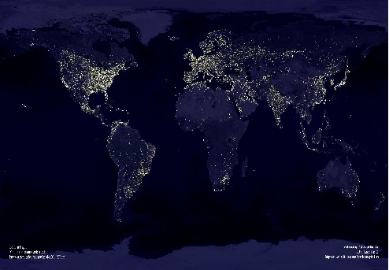
Essential ?’s
What are the differences between political maps and physical maps?
What are everyday examples of special purpose maps?

Slide 3
Map Items of Student Interactive Map (SIM)
Croatia
Bosnia
Serbia
North Korea
South Korea
Nunavut

Slide 4
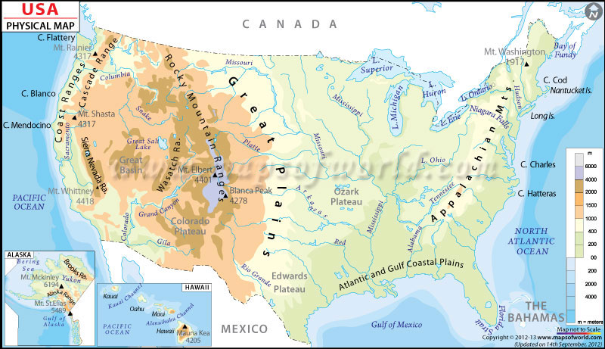
Vocabulary
Political Map – identify where countries are located.
Also the subdivisions of countries into:
States, Provinces, Territories, Cities, or even smaller Voting districts or School district boundaries.
Physical Map – illustrate physical, or Naturally occurring features or Natural resources:
Mountain Ranges, Deserts, Forests, Rivers, Sea, Oceans
Salt, Oil, Coal, Gold, Diamonds, Iron ore
Special Interest Map/Special Purpose Map - illustrates something that is not purely political or physical.
Weather Patterns, Sport Teams, Candidate Voting Precincts, Battle Zones

Slide 5
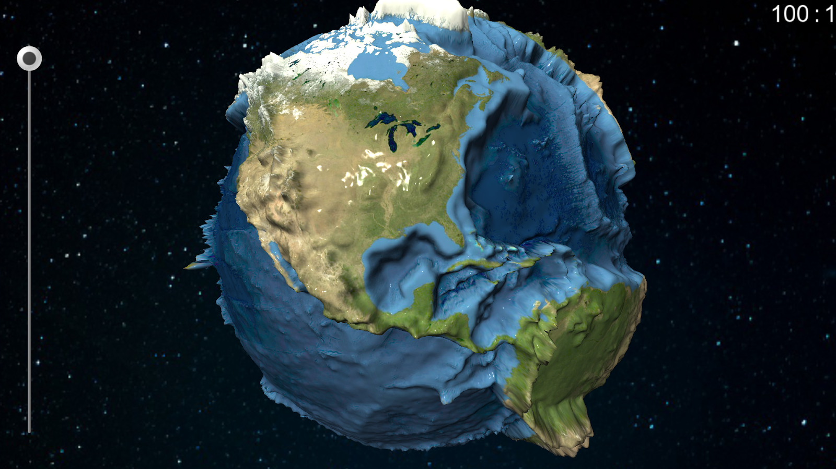
Identify the Types of Maps That Follow!!
WHAT DO YOU SEE IN THE MAPS THAT LOOK SIMILAR TO THE OTHERS?
WHAT ARE THE PARTS OF THE MAP THAT HELP YOU CATEGORIZE IT?

Slide 6
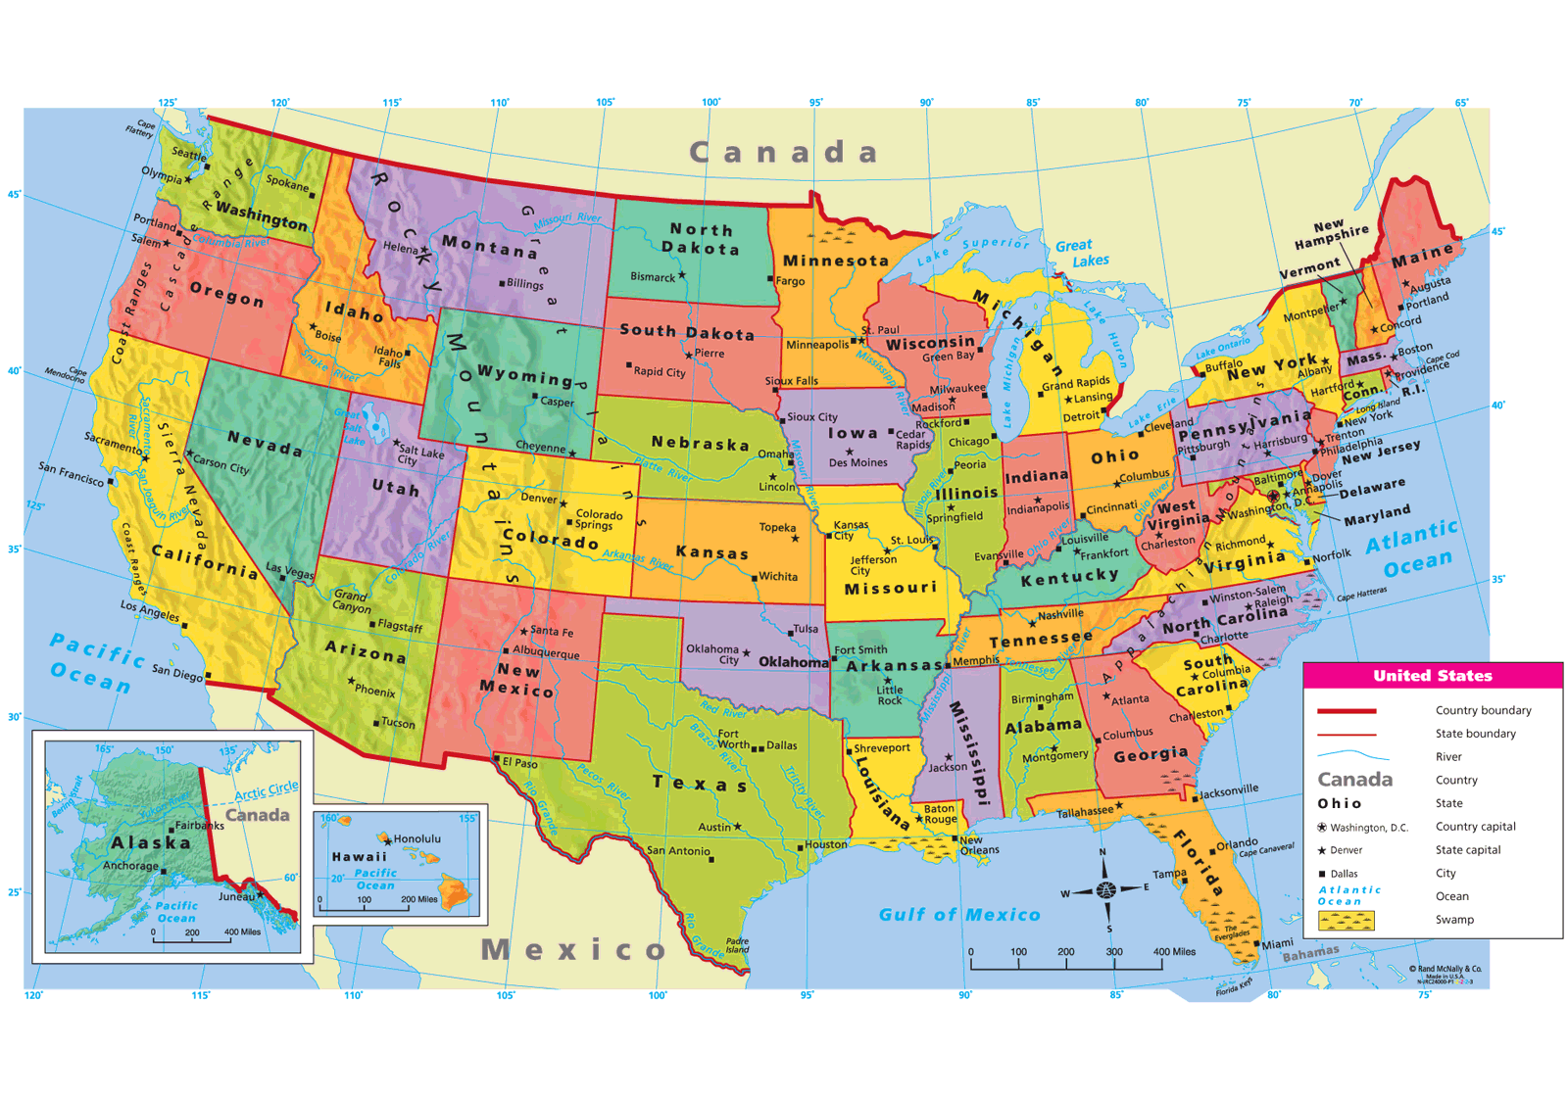

Slide 7
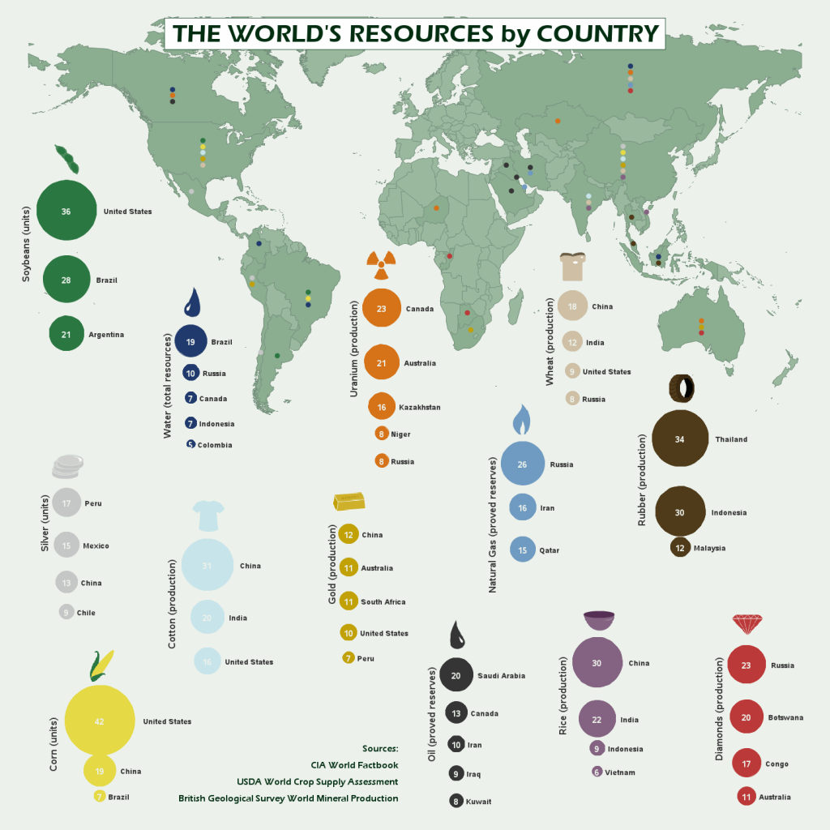

Slide 8
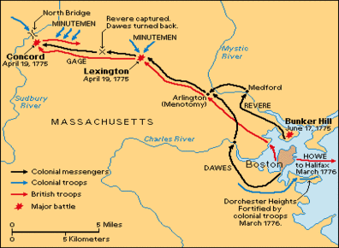

Slide 9
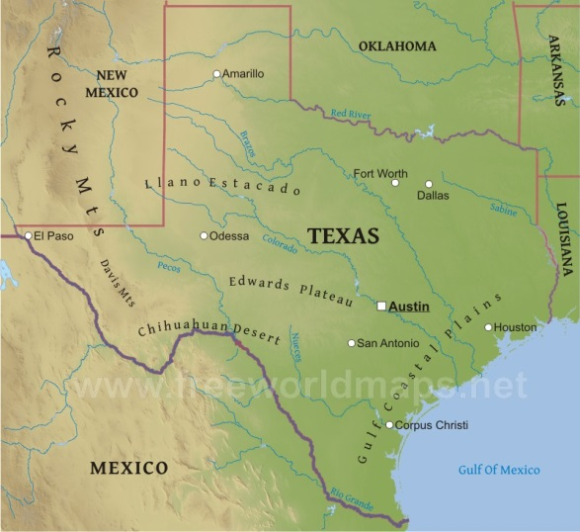

Slide 10
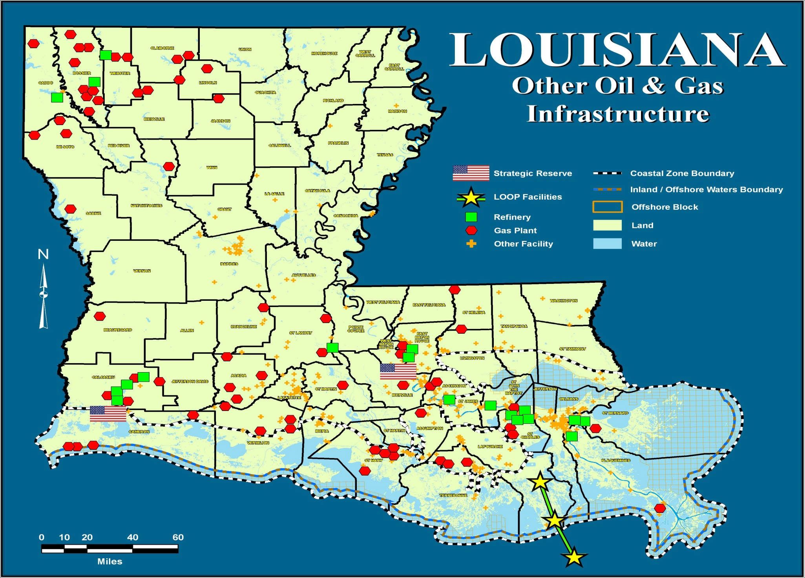

Slide 11
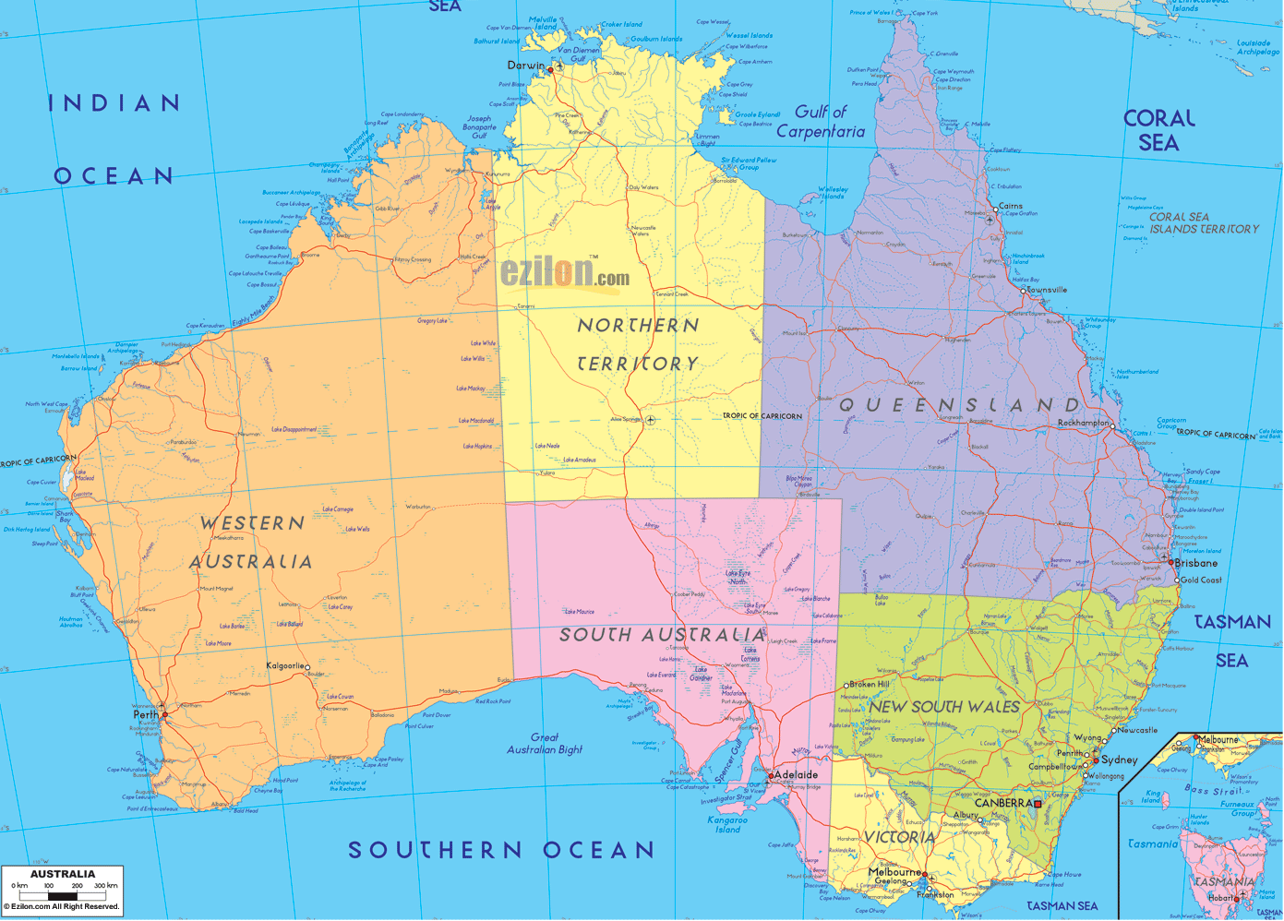

Slide 12
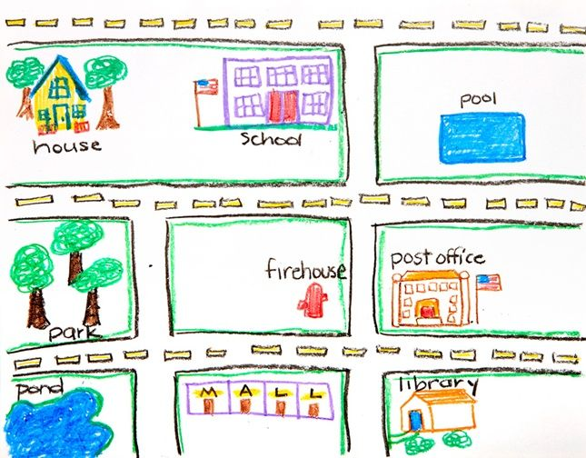
Sketch a Map in 5 mins. ☺
Sketch a map between places your familiar with
Routes to school, Cities or States lived in, Place you traveled too
Briefly look at neighbors
Class Discussion ?’s
What specific things did you include on your map?
What things did you omit?

Slide 13
Must Have Copied on Back of SIM TODALSIGSS
T-Title
O-Orientation (compass)
D-Date (when map made)
A-Author (student’s name)
L-Legend or key
S-Scale
I-Index (alphabetical listing of every major location)
G-Grid (lines of latitude/longitude)
S-Source (information put on the map)
S-Surrounding (land around object labeled)

Slide 14
Work Time ☺
Complete IR-8
Using Reading from IR-9
Create a Final Map (like map 1) making necessary adjustments to include TODALSIGSS

