Slide 1
POLITICAL GEOGRAPHY & GLOBALIZATION
UNIT 6 LESSON 6
DEVOLUTION

Slide 2
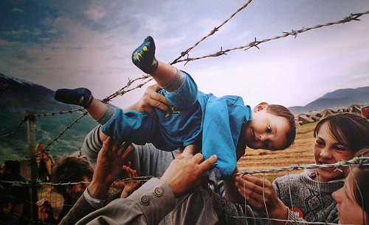
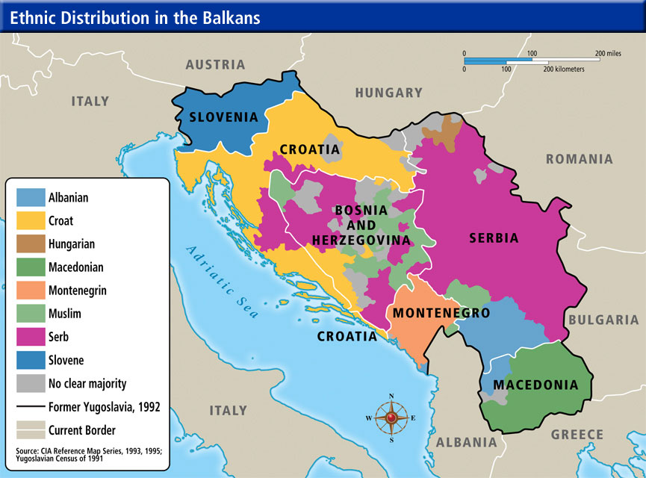
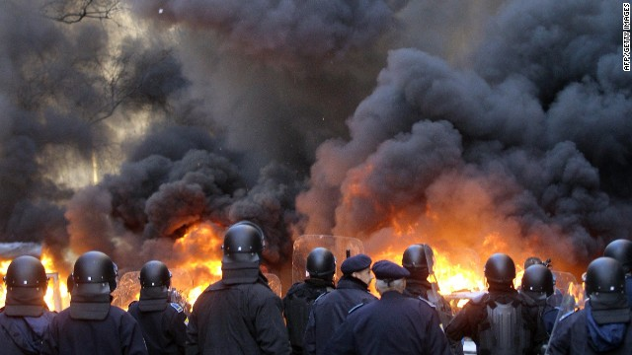
ESSENTIAL ?’S
How did the size of the land region of the Soviet Union contribute to the process of devolution?
What role did ethnic tensions throughout the Balkan Peninsula play in the process of devolution in the former Yugoslavia?

Slide 3
MAP ITEMS ON SIM
Soviet Union
Latvia
Lithuania
Estonia
Armenia
Azerbaijan
Georgia
Ukraine
Moldova
Belarus
Bosnia & Herzegovina
Croatia
Slovenia
Macedonia
Serbia
Montenegro

Slide 4
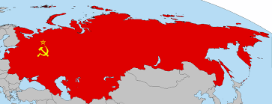
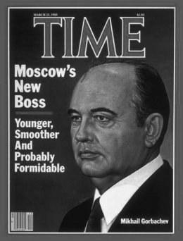
VOCABULARY
Devolution – refers to the change in power & authority to govern from a centralized government structure to a regional structure. More of a divided system of authority.
Soviet Union – (The Union of Soviet Socialist Republics/USSR) founded 1921 by Bolshevik Party led by Vladimir Lenin.
Lasted till Jan. 1992 when the once powerful country dissolved into 15 independent republics
Glasnost – Free Speech
1st revolutionary idea introduced by Mikhail Gorbachev
Perestroika – Economic Reform or Rebuilding
2nd revolutionary idea

Slide 5
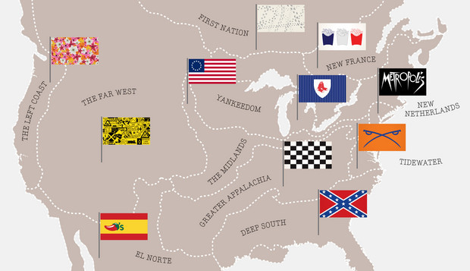
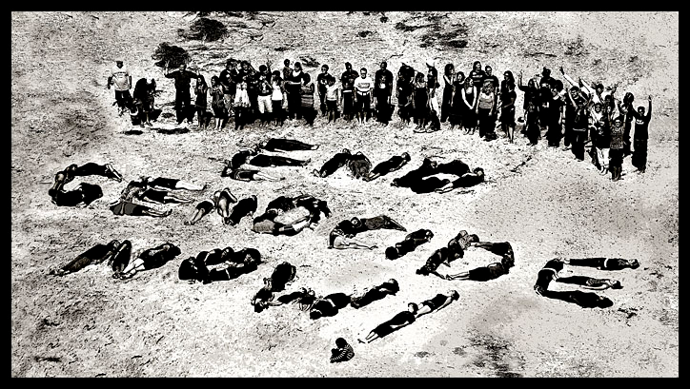
VOCAB. CONTINUED ☺
Puppet Government – one in which the political leaders were strongly influenced by a stronger government elsewhere.
Balkanization – refers to the breakup of a multinational state into small states or regions that are more ethnically similar.
Genocide – the systematic extermination of a group of people.
Ex. Nazi towards Jew
Serbs towards Bosnians

Slide 6
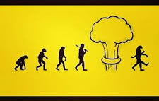
THINK, PAIR, SHARE & DISCUSSION
Briefly discuss in groups and share when asked.
What ideas or differences do you have when you read the following terms:
EVOLUTION
the gradual development of something, especially from a simple to a more complex form.
REVOULTION
a forcible overthrow of a government or social order in favor of a new system.
DEVOLUTION
the transfer or delegation of power to a lower level, especially by central government to local or regional administration.

Slide 7
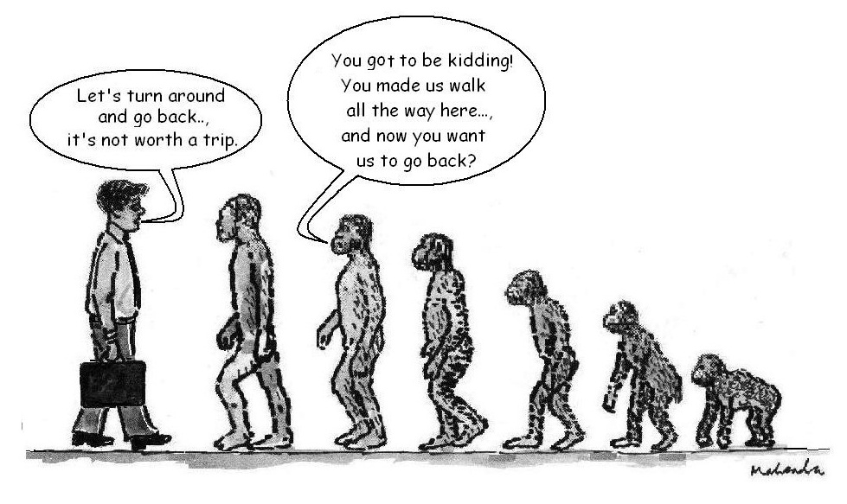
DEVOLUTION
In your groups identify:
Empires or Countries that have undergone the process of devolution.
Share response when asked

Slide 8
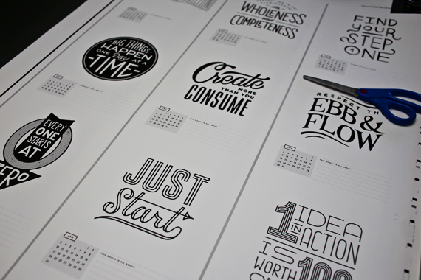
WORK TIME ☺
Complete chart from IR-28 & 31 using the Reading from IR-29

