Slide 1
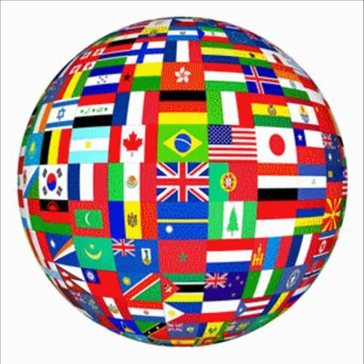
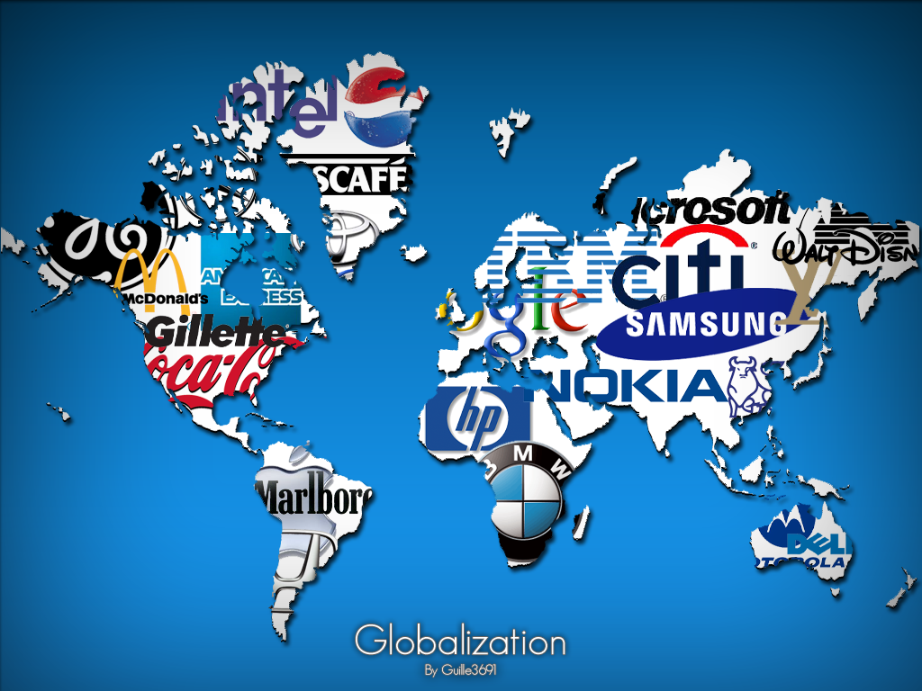
POLITICAL GEOGRAPHY & GLOBALIZATION
UNIT 6 LESSON 1
BOUNDARIES & POLITICAL BORDERS

Slide 2
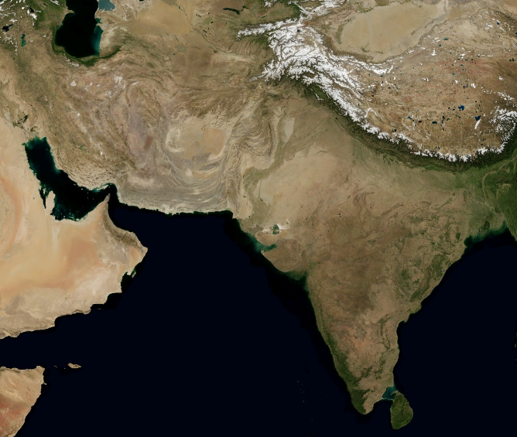
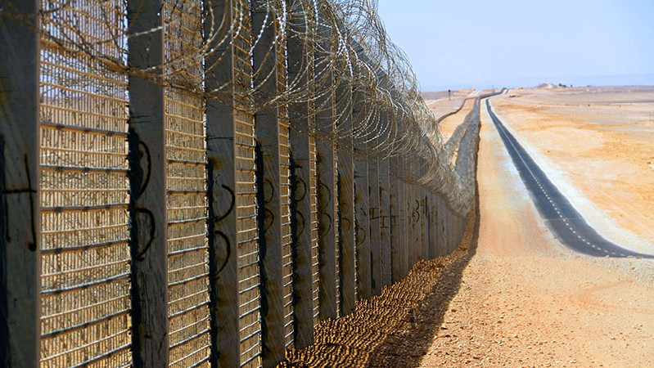
ESSENTIAL ?’S
In what ways can physical boundaries be good borders?
In what ways can physical boundaries be poor borders?
Why do people have trouble agreeing on borders and living peacefully on either side of the designated boundary?

Slide 3
MAP ITEMS ON SIM
Himalaya Mountains
Hindu Kush Mountains
Afghanistan
Pakistan
Andes Mountains
Chile
Argentina
Pacific Ocean
Atlantic Ocean
Vietnam
South China Sea
Canada
United States
Great Lakes
Kenya
Tanzania
Uganda
Lake Victoria
Danube River
Mekong River
Rio Grande
Texas
Mexico
India
Israel
Egypt
Lebanon
Syria
Iraq
North Korea
South Korea

Slide 4
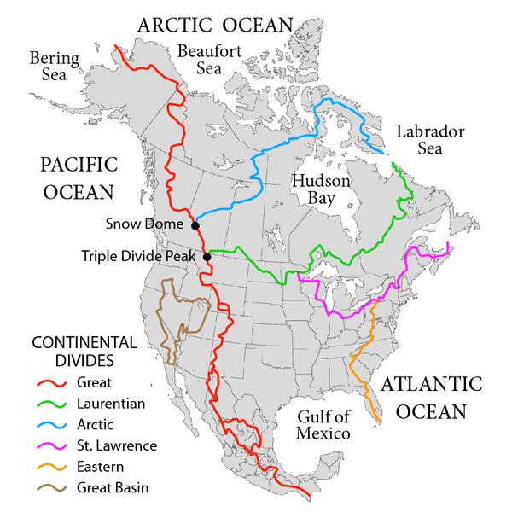
VOCABULARY
Political Geography – the spatial analysis of the political organization of Earth.
Continental Divide – the continuous ridge that divides rainfall and snowmelt flowing into the Pacific & Atlantic Oceans.

Slide 5
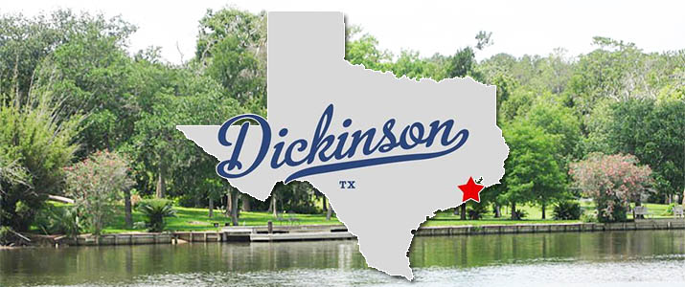
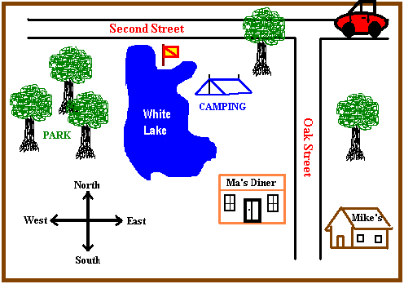
ARTWORK & DISCUSSION
Draw a Map of Dickinson.
Identify
I-45
Hwy 146
Hwy 3
FM 517 & 646
DHS and other schools on district
Your Home
Landmarks (stores, restaurants)
Trace
Human Boundaries in RED
Physical Boundaries in GREEN
Sub-Boundaries in PURPLE
Neighborhoods, School Feeder Patterns, or Demographic Regions
Why do you think the land is divided this way?
What sub-boundaries are defined on your map?

Slide 6
101
106- Hughes Rd Elem
101- KE Little
108- San Leon Elem
105- Jake Silbernagel
107- Bay Colony Elem
109- Calder Rd Elem
105
108
107
109
106
146
45
3

Slide 7
MAP SKILLS GROUP WORK
Complete the labeling process for IR/1 – IR/5
Following instructions provided on pack.

Slide 8
INDIVIDUAL WORK
Read IR-6 and complete multiple choice from IR-8
What are physical/natural borders?
What are man-made borders?
What political issues are associated with the maps from the reading?
What is your opinion of these political issues?

Slide 9
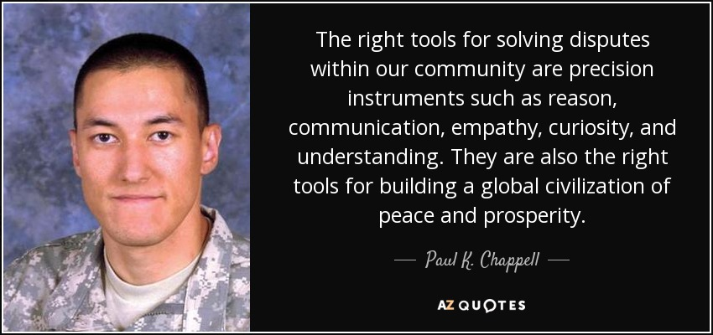
GROUP WORK IR-7
Each group will chose a problem from the reading to complete the Problem-Solution Notes from IR-7.
Disputes:
Whether the Andes Mountains between Chile and Argentina should be drawn as a jagged line from 1 crest of the mountain to another or a line that follows the continental divide
The movement of the Rio Grande between Texas and Mexico
Who should own the Eastern shores of the Mediterranean Sea
Who should control the Korean Peninsula

