Slide 1
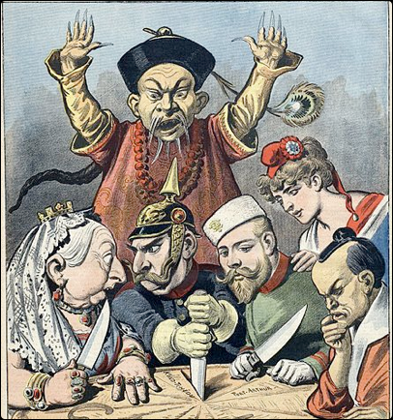
Political Geography & Globalization
UNIT 6 LESSON 4
BOUNDARY EFFECTS OF IMPERIALISM

Slide 2
Essential ?’s
What are some effects of political instability in Africa as a result of post-European colonization?
How are the conflict and violence in northern India today a result of European colonization?

Slide 3
Map Items on SIM
Sierra Leone
Senegal
Liberia
Nigeria
Sudan
Rwanda
Angola
Somalia
India
United Kingdom
Pakistan
Bangladesh
Punjab

Slide 4
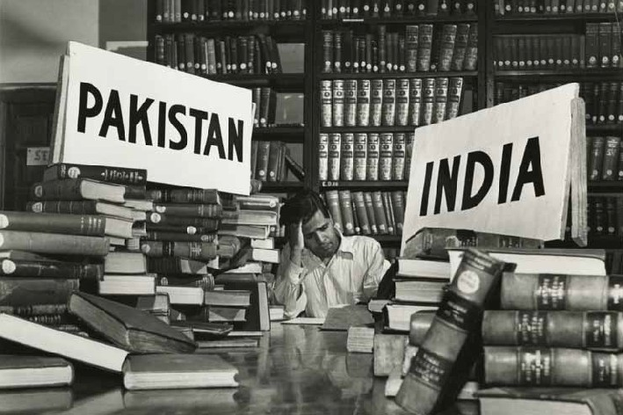
Vocabulary
Partition - divided

Slide 5
Work Time ☺
Complete IR-18 first.
Complete IR-19&21
Using reading from IR-20

